Slide 1

Hands-on Schedule
Abstractions
Part II: Synthesis
Presenter: Yitian Sun
Synthesis
Tensor
Linalg
ADL Language
Analysis
Apps
Transform
Scheduling
Affine
SCF
Stream
MLIR
Compiler
MemRef
Arith
APS
Part III: Compiler
Presenter: Chenyun Yin
Flexible-levels
Instr. Finding
CMT
Firrtl
Pattern-based
Retargeting
C/C++ Frontend
ML Pipeline
hw
comb
seq
Part I: HDL and Instruction Finding
Presenter: Youwei Xiao
Architecture
Circuit
Interconnect
Memory System
GAA abstraction
Dyn pipeline
HDL Elaboration
Task Scheduler
Part IV: Arch and Deployment
Presenter: Yuyang Zou
EDA Backends
Simulation
Synthesis
Phys. Impl.
FPGA Deployment

Slide 2
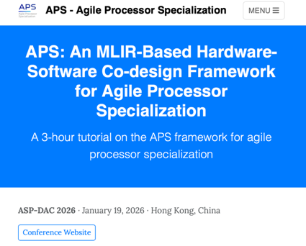

Website
Project website: https://aps.ericlyun.me
Tutorial (today) page: https://aps.ericlyun.me/tutorials/aspdac-2026/
QR Code:

Slide 3
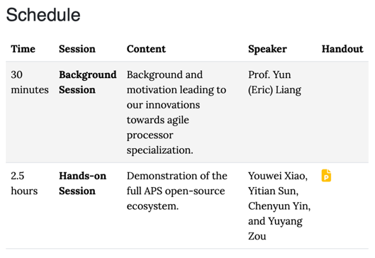
Website
Project website: https://aps.ericlyun.me
Tutorial (today) page: https://aps.ericlyun.me/tutorials/aspdac-2026/
QR Code:
Download slides!

Slide 4
Setup
Login our server
First, you need a SSH key
check if your SSH directory exists
win: C:\Users\<username>/.ssh
linux: $HOME/.ssh
mac: /Users/<username>/.ssh
if not exists, create one
reference link
# Windows, open PowerShell
ssh-keygen -t ed25519 -C "<email>"
# Linux, open terminal
ssh-keygen -t ed25519 -C "<email>"
# Mac, open terminal
ssh-keygen -t ed25519 -C "<email>"
SSH public key can be found in <SSH>/id_ed25519.pub

Slide 5
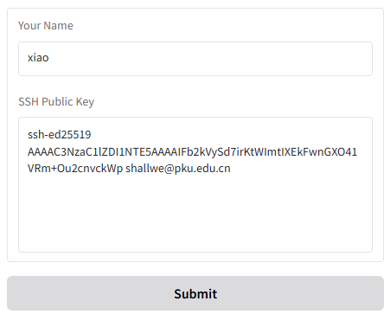
Setup
Login our server
https://login.aps.ericlyun.me
Enter your name and ssh key
Follow the output to connect

Slide 6
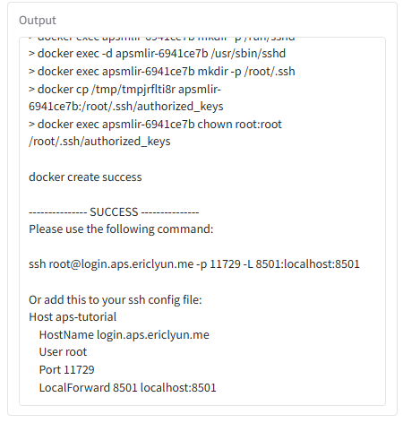
Setup
Login our server
https://login.aps.ericlyun.me
Enter your name and ssh key
Follow the output to connect
Here is the SSH command for connection

Slide 7
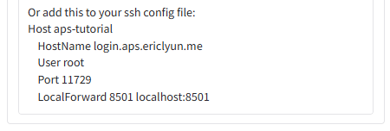
Setup
Login our server
You can use PowerShell/terminal
Or, you can use VSCode
Ctrl-Shift-P / ⇧⌘P, type Remote: Show Remote Menu
select SSH to install the extension
Ctrl-Shift-P / ⇧⌘P, type Remote-SSH: Open SSH Configuration File
paste
Ctrl-Shift-P / ⇧⌘P, type Remote-SSH: Connect to Host
pick “aps-tutorial”; pick “Linux”, “Yes”; wait for success
Here is the SSH configuration to be copied

Slide 8
Setup
Login our server
You can use PowerShell/terminal
Or, you can use VSCode
Where are the demos?
Ctrl-J / ⌘J to open a terminal, run “ls /root”, you can see “aps” and “cmt2”
Open the folder?
Ctrl-K+O / ⌘K+O, select “/root/” and open
Now we are ready to start the hands-on session!

Slide 9
HDL and Instruction Finding
Speaker: Youwei Xiao
肖有为

Slide 10
Part I: HDL and Instruction Finding
HDL
What is Cement?
Cmt2 basics and examples
Circt-cmt2
Instruction finding
ISAMORE (ASPLOS’26)
finding reusable instructions via e-graph anti-unification

Slide 11









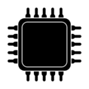


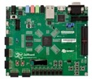
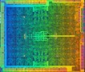


Position of HDL in APS Flow
Domain Applications
Base Processors
Rocket
BOOM
CVA6
CV32E
ISAX MLIR
ISAMORE
APS
Frontend
APS
Synthesizer
Cement CIRCT
Processor
RTL
.cadl
RTL
Cross-level
ISAX Description
APS
Compiler
FPGA
Flow
ASIC Flow
Software
Hardware

Slide 12
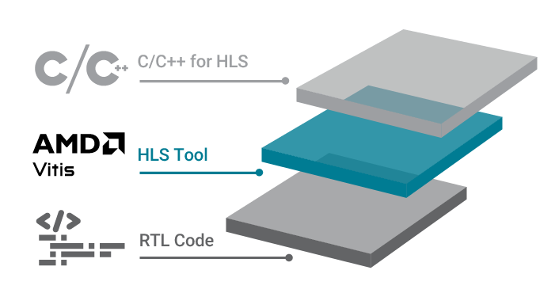



Cement: Better HDL and Framework for Chip Design
Traditional HDL
tedious hardware code
Embedded HDL (eHDL)
design hardware in advanced programming language (Scala, Python)
?
HLS: design hardware in C/C++
Cement (cmt2!)
Rust-embedded HDL
software-like control description
keep evolving…
Cement (cmt1)
published at FPGA’24
rule-based design
Youwei Xiao, Zizhang Luo, Kexing Zhou, and Yun Liang. 2024. Cement: Streamlining FPGA Hardware Design with Cycle-Deterministic eHDL and Synthesis. FPGA '24. https://doi.org/10.1145/3626202.3637561
High-level HDL: describe hardware as rules

Slide 13
Today, we introduce cmt2!
as the successor of …
Cement (cmt1)
published at FPGA’24
Rust-embedded HDL
cmt2!
rule-based design
software-like control description

Slide 14
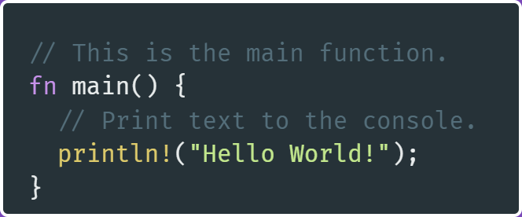
Hello Rust World!
touch /root/cmt2/crates/cmtc/examples/hello.rs
create hello.rs file ↑
click [run] above fn main, or …
under directory /root/cmts
Cargo is Rust’s build system and package manager. It’s easy-to-use!
More user-friendly than sbt for Scala/Chisel!
cargo run --example hello

Slide 15
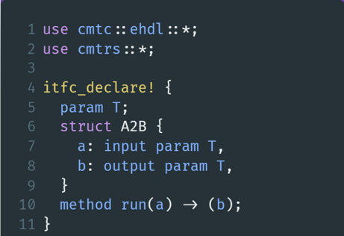
Hello cmt2!
at the top of hello.rs
use clauses import cmt2’s eHDL and compiler features
itfc_declare! is a macro
macro in Rust transforms code at the token-level

Slide 16
Hello cmt2!
at the top of hello.rs
macro is an advanced feature in Rust!
Please leave cmt2 developers to suffer😂
and… just use them!😁
The left code creates …
A module interface named A2B;
It has one input port a, one output port b, both of which have type T.
It exposes a method run for external world to invoke!
A2B
a:T
method run
b:T

Slide 17
cmt2 is rule-based HDL
at the top of hello.rs
A2B
a:T
method run
b:T
cmt2!
rule-based design
Hardware logic is organized as rules – the execution unit!
Don’t be afriad!😁
Just consider one rule as a group of operations that execute together
In cmt2, we have two types of rules: method rules and always rules:
method rule need to be invoked (Bluespec method)
always rule runs actively (Bluespec rule)

Slide 18
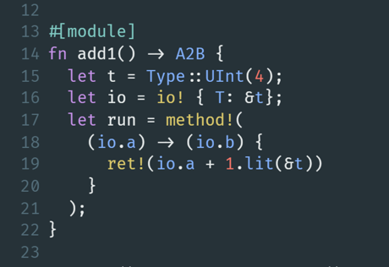
cmt2 is rule-based HDL
following itfc_declare!
fn starts a function!
The #[module] macro transfoms the function add1 to create a module of the interface A2B
UInt(4)
add1 of
A2B
a:T
method run
b:T
b=a+1
Now, types are given, rules are filled -- Module is completely described!

Slide 19
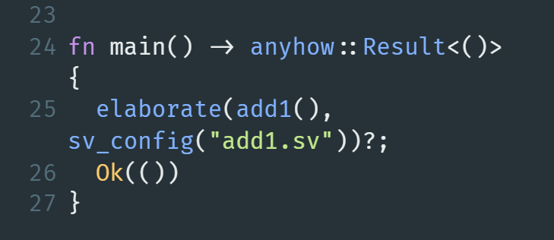
cmt2 generates SystemVerilog
following fn add1
The new main function to call elaborate for the add1 module
click [run] above fn main, or …
cargo run --example hello
cat add1.sv

Slide 20
Show features by examples
as the successor of …
Cement (cmt1)
published at FPGA’24
FIR
GEMM
Rust-embedded HDL
cmt2!
rule-based design
software-like control description

Slide 21
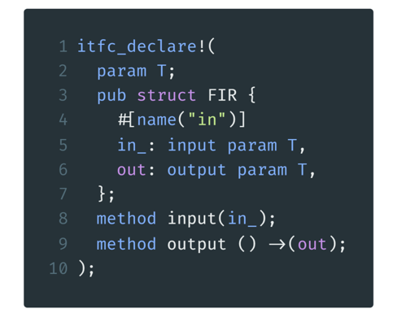
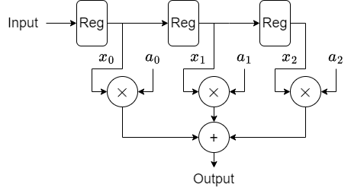
Finite Impulse Response
cmt2!
Rust-embedded HDL
./crates/cmtc/examples/fir.rs line 7-16

Slide 22
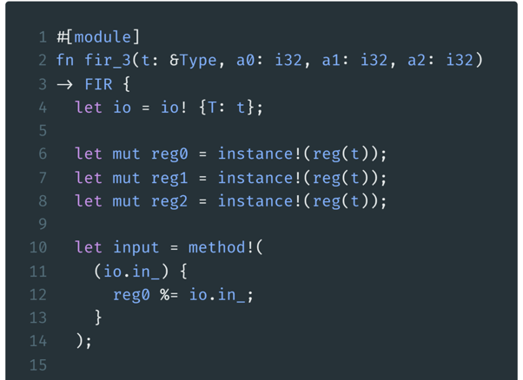
FIR Example1: fixed length
Parameters: type & coefficients
instantiate a
Reg as submodule
things to do after the method is invoked
reg %= xx is a syntax sugar for reg.write(xx)
rule-based design
./crates/cmtc/examples/fir.rs line 18-46

Slide 23
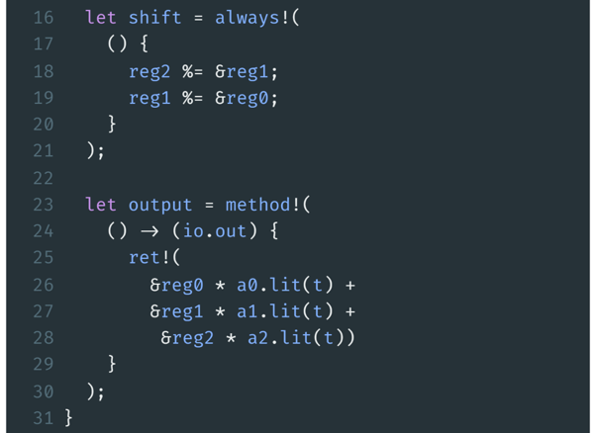
FIR Example1: fixed length
shift the registers
implement the output method
./crates/cmtc/examples/fir.rs line 18-46

Slide 24
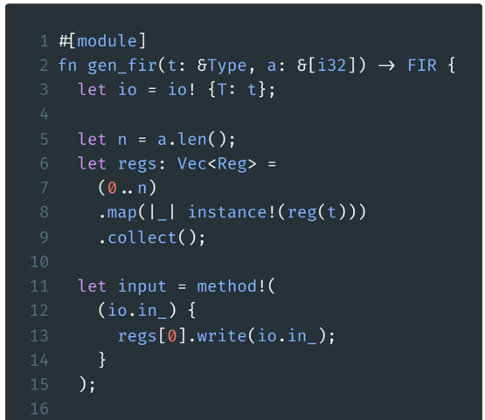
FIR Example2: arbitrary length
An array of coefficients
Instantiate
a vector of
Regs
Input to the first reg
Rust-embedded HDL
./crates/cmtc/examples/fir.rs line 48-78

Slide 25
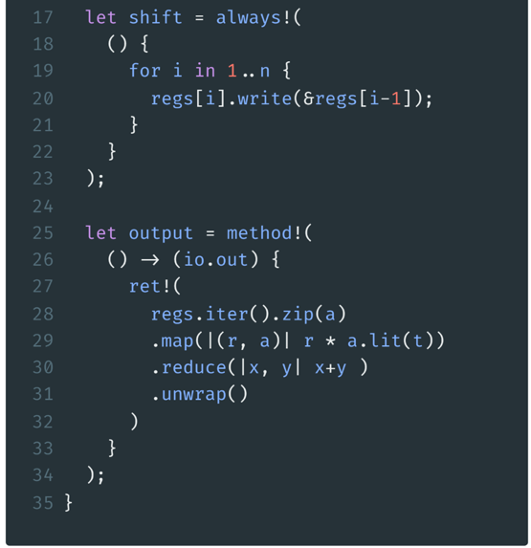
FIR Example2: arbitrary length
Generate n-1 shifts with a software for expression
Make a multiply accumulate expression with functional programming
./crates/cmtc/examples/fir.rs line 48-78

Slide 26
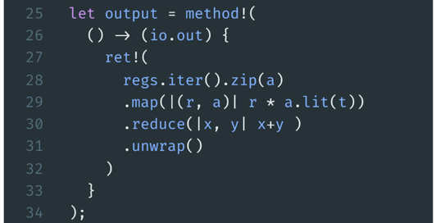
Explanation on the last expression
For audiences that are not familiar with functional programming
regs
a
map()
zip()
reg0
$$×$$
a0
reg1
$$×$$
a1
$$+$$
reg2
$$×$$
a2
$$+$$
reduce()
reg3
$$×$$
a3
$$+$$
Rust-embedded HDL
iter()
Option<Sum>
unwrap()
Sum

Slide 27
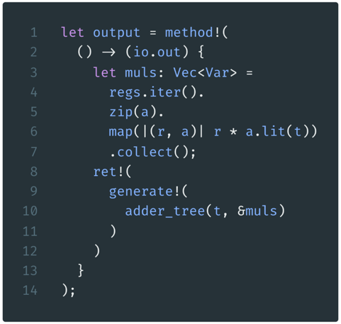
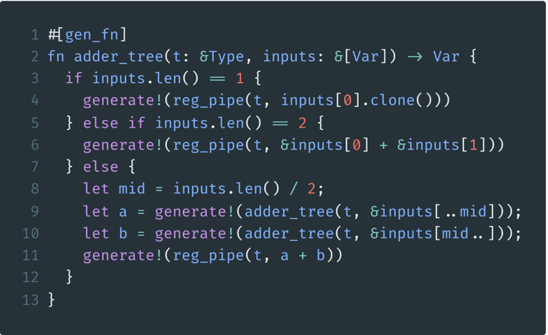
FIR Example3: adder tree
a gen_fn generates hardware
generate an adder tree
./crates/cmtc/examples/fir.rs line 83-123

Slide 28
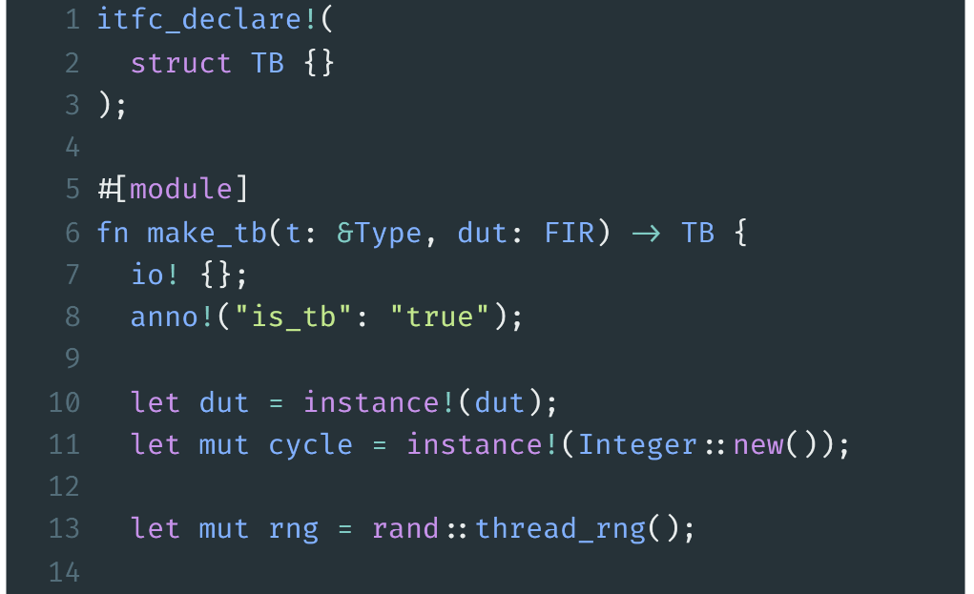
FIR Example: Testbench preparation
the interface for the testbench
pass the DUT into the TB
tell the compiler this is a TB
instantiate DUT
./crates/cmtc/examples/fir.rs line 132-174

Slide 29
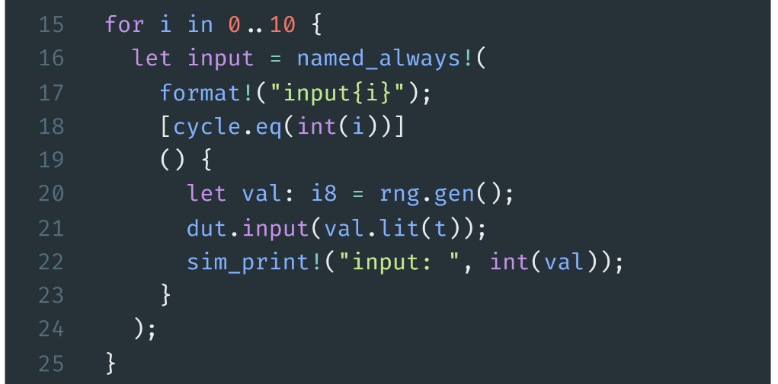
FIR Example: Testbench inputs
make 10 inputs
make 10 always rules with different name
./crates/cmtc/examples/fir.rs line 132-174

Slide 30
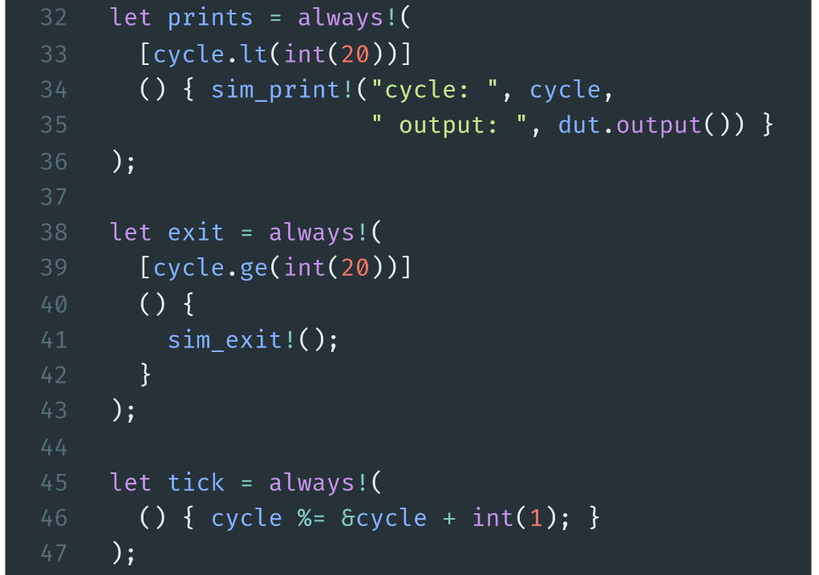
FIR Example: Testbench inputs
print during simulation
finish simulation at cycle 20
increase cycle counter
./crates/cmtc/examples/fir.rs line 132-174

Slide 31
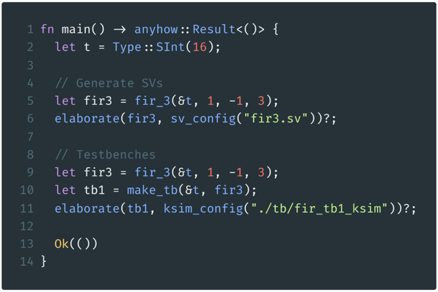
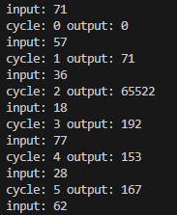
FIR Example: Elaboration & Simulation
main function of Rust
cd /root/cmt2
cargo run –-example fir
cd ./tb/fir_tb1_ksim
make all
./FIR_s6
Elaborate to generate simulation environment
./crates/cmtc/examples/fir.rs line 176-204
Possible Outputs

Slide 32
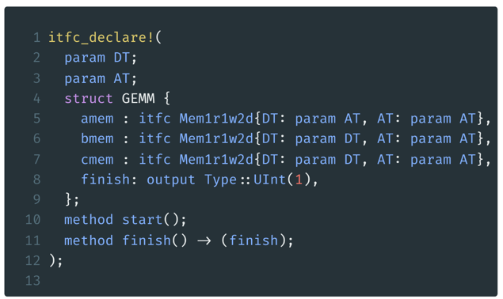
GEMM
cmt2!
write()
software-like control description
A Mem
GEMM
read()
memory as sub-interface
B Mem
$$×$$
F
S
M
$$+$$
MAC
simple methods to start computation and report finish
C Mem
./crates/cmtc/examples/gemm.rs line 25-36

Slide 33
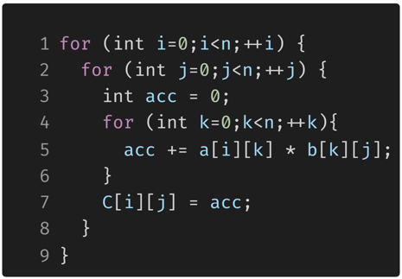
GEMM Example: Software
k
A
k
B
C
j
i
GeMM in C using three for-loops

Slide 34
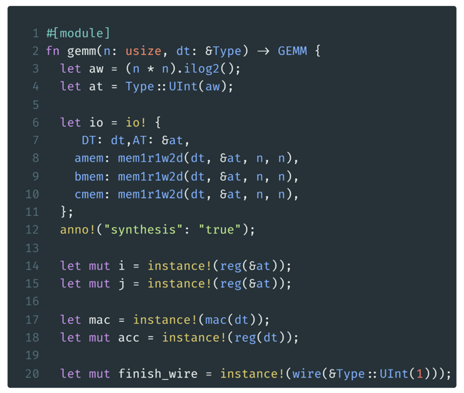
GEMM Example: Preperation
calculate the address type
provide the memory instances to the interface
some register for loops
one MAC unit
one accumulator
./crates/cmtc/examples/gemm.rs line 38-97

Slide 35
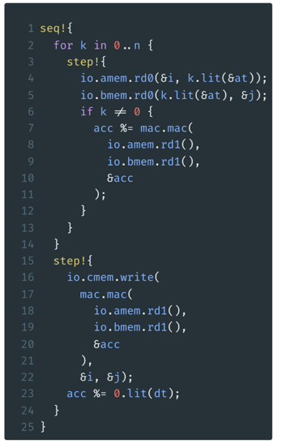
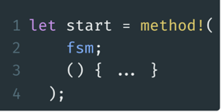
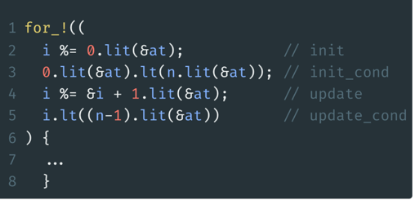
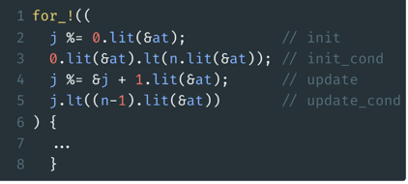
GEMM Example: FSM
software-like control description
keyword
i= 0 to n-1
a for loop
init: i=0
i<n i=0 => 0<n
update: i=i+1
i<n i=i+1 => i<n-1
j= 0 to n-1
./crates/cmtc/examples/gemm.rs line 38-97

Slide 36
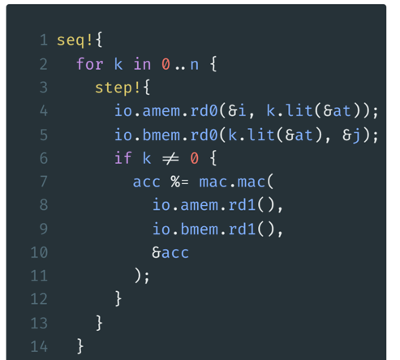
GEMM Example: FSM innermost body
for i in 0..n
for j in 0..n
Seq
step0
step1
step2
step3
the following steps will be done in a sequence
amem.rd0
amem.rd0
amem.rd0
amem.rd0
generate n steps
bmem.rd1
bmem.rd1
bmem.rd1
bmem.rd1
The same for all n steps
amem.rd1
amem.rd1
amem.rd1
bmem.rd1
bmem.rd1
bmem.rd1
feed memory address
get memory data
invoke MAC
accumulate result
mac
mac
mac
acc
acc
acc
$$⋮$$
./crates/cmtc/examples/gemm.rs line 38-97

Slide 37
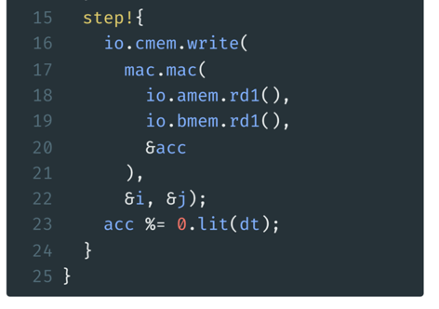
GEMM Example: FSM last step
for i in 0..n
for j in 0..n
Seq
step0
step1
step2
step3
$$⋯$$
step n
$$⋮$$
amem.rd0
amem.rd0
amem.rd0
amem.rd0
write to cmem
bmem.rd1
bmem.rd1
bmem.rd1
bmem.rd1
last mem read and MAC
amem.rd1
amem.rd1
amem.rd1
amem.rd1
bmem.rd1
bmem.rd1
bmem.rd1
bmem.rd1
mac
mac
mac
mac
acc
acc
acc
acc
cmem.write
./crates/cmtc/examples/gemm.rs line 38-97

Slide 38
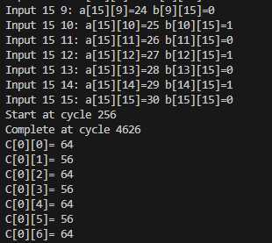
GEMM Example: Simulation
cd /root/cmt2
cargo run –-example gemm
cd ./tb/gemm_ksim
make all
./GEMM_s16_i8
4370
Commands to run simulation
Expected results
Cycles= ($(16+1)$ //k
$×16+1)$ //j
$×16+1$ //i
= 4369
+ 1 cycle to init
+ 1 cycle to init
+ 1 cycle to write finish

Slide 39
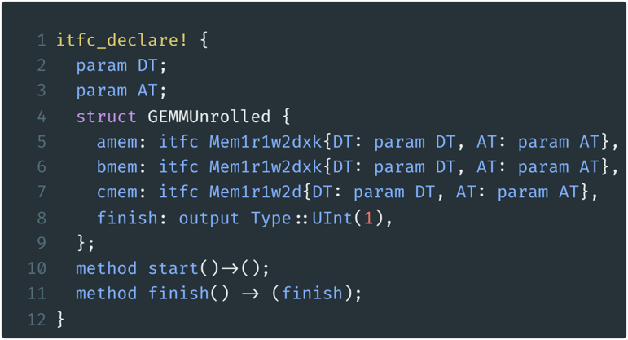
GEMM unrolled Example: Interface Declare
Mem
Mem
Mem
Mem
GEMM
Unrolled
Multi-bank 2D memory
Mem
MAC
MAC
MAC
MAC
Mem
Mem
Mem
$$+$$
FSM
C Mem
./crates/cmtc/examples/gemm_unrolled.rs line 25-36

Slide 40
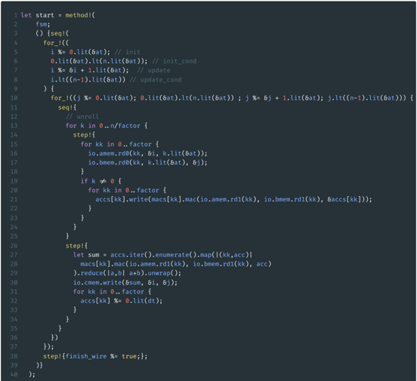
GEMM unrolled Example
i
j
k
./crates/cmtc/examples/gemm_unrolled.rs
line 38-114

Slide 41
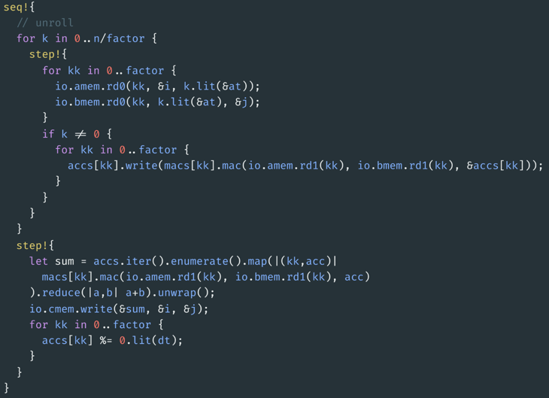
GEMM unrolled Example: innermost
for i in 0..n
for j in 0..n
Each inner loop have n/factor+1 steps
read factor memory banks at the same time
invoke factor MACs and accumulate
get the sum of all accumulators
write to c memory
./crates/cmtc/examples/gemm_unrolled.rs
line 38-114

Slide 42
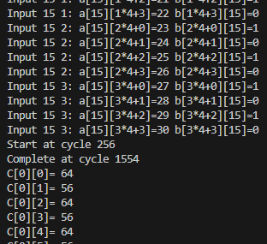
GEMM unrolled Example: Simulation
cd /root/cmt2
cargo run –-example gemm_unrolled
cd ./tb/gemm_unrolled_ksim
make all
./GEMMUnrolled_s16_i8
1298
Commands to run simulation
4370/1298$≈$3.37
Factor=4 results
Cycles= ($(4+1)$ //k
$×16+1)$ //j
$×16+1$ //i
= 1297

Slide 43



We’ve integrated Cement into APS!
Traditional HDL
tedious hardware code
Embedded HDL (eHDL)
design hardware in advanced programming language (Scala, Python)
HLS: design hardware in C/C++
①
③
Rust-embedded HDL
software-like control description
Migration for APS integration
circt-cmt2
Cement (cmt2!)
Cement (cmt1)
published at FPGA’24
②
Keep evolving…
rule-based design
Youwei Xiao, Zizhang Luo, Kexing Zhou, and Yun Liang. 2024. Cement: Streamlining FPGA Hardware Design with Cycle-Deterministic eHDL and Synthesis. FPGA '24. https://doi.org/10.1145/3626202.3637561
High-level HDL: describe hardware as transactions/rules

Slide 44
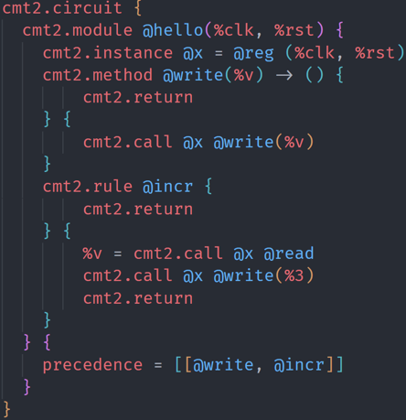
circt-cmt2
We implement cmt2 as a new dialect in CIRCT
MLIR/CIRCT Dialects
Tensor
Linalg
Affine
SCF
Stream
MemRef
Arith
APS
code (or cat) circt/test/Dialect/Cmt2/hello.mlir
APS synthesis flow
Cmt2
Cmt2ToFIRRTL conversion
FIRRTL
HW
Comb
…

Slide 45
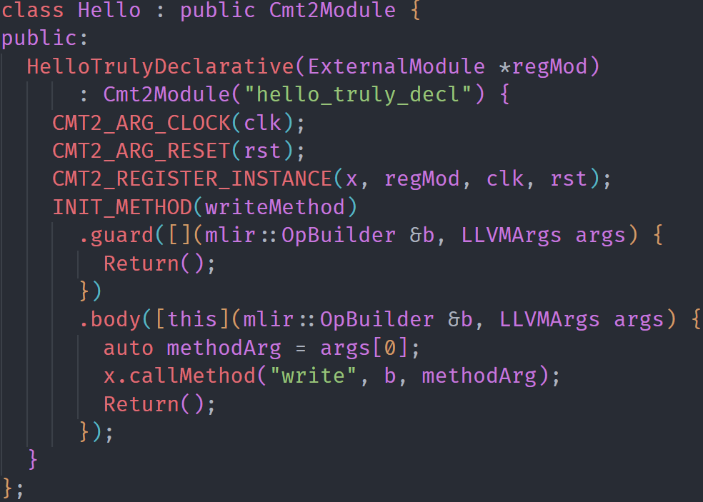
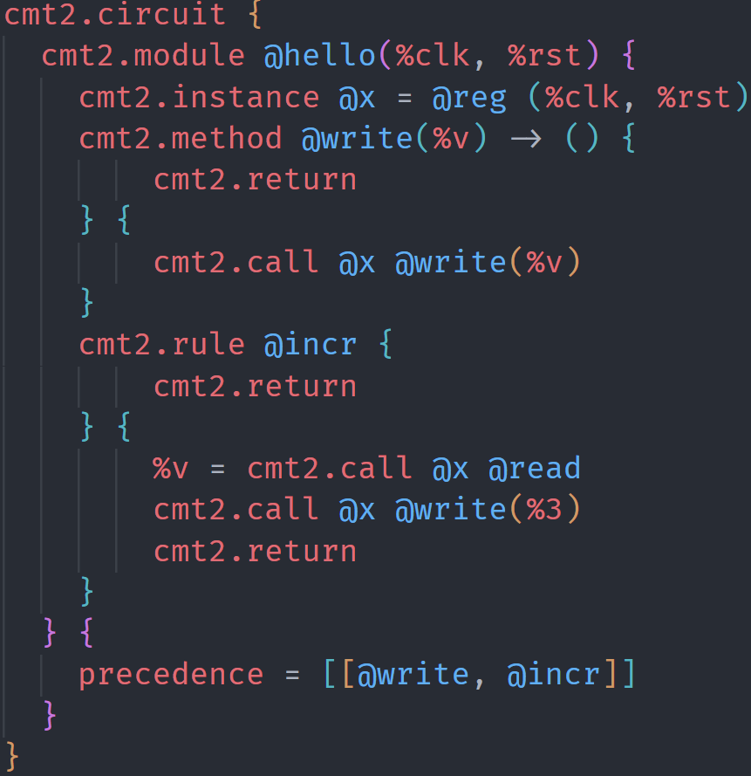
circt-cmt2 EDSL
For productive programming circt-cmt2, we provide a C++-based EDSL. It is used by APS’s synthesizer.
code circt/examples/ECMT2/hello_v3.cpp
construct

Slide 46
Instruction Finding
Domain Applications
Base Processors
Rocket
BOOM
CVA6
CV32E
ISAX MLIR
ISAMORE
APS
Frontend
APS
Synthesizer
Cement CIRCT
Processor
RTL
.cadl
RTL
Cross-level
ISAX Description
APS
Compiler
FPGA
Flow
ASIC Flow
Software
Hardware

Slide 47
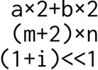
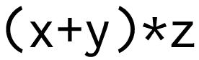
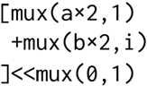
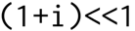
Reusability is a key concern
We should find reusable instructions to customize.
If we have …
Domain Applications
and many other expressions in applications.
A. Multiple custom instructions
Three custom instructions.
C. Semantically reusable instruction
(ideal)
Costly, redundant
B. Syntactic merging: prior work
Ad-hoc
HW-inefficient
General, efficient

Slide 48
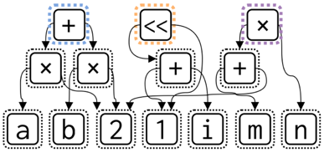
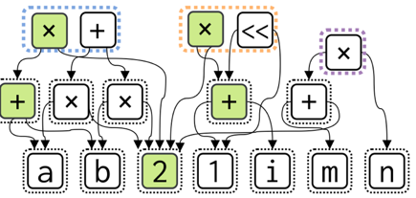



Find Reusable Instructions via E-Graph Anti-Unification
E-graph is a data structure to compactly represent equivalent terms.
E-node: term or subexpression
E-class: contains equivalent e-nodes
$$x×z+y×z⇝\left(x+y\right)×z$$
Initial E-graph
$$x≪1⇝x×2$$
Saturated (partially) E-graph

Slide 49


Find Reusable Instructions via E-Graph Anti-Unification
Anti-unification is the process of constructing a generalization common to two given symbolic expressions
Anti-unify
$$\left(3∗b\right) ⨆ \left(a∗2\right)⇝x×y$$
finds common pattern
①
②
① Green terms are found common
② Red terms are found common

Slide 50

ISAMORE Framework
We’ll present ISAMORE at ASPLOS 2026!
Domain Applications
ISAMORE
.cadl
We are working on ISAMORE’s integration into APS.

Slide 51
Hardware Synthesis
Speaker: Yitian Sun
孙逸天

Slide 52
Before Getting Started
Please run pixi shell in the ~/aps directory
CHECK：
pixi shell
(aps-mlir) root@server:~/aps

Slide 53
Outline
Challenges in ASIP hardware synthesis
APS hardware synthesis flow
Cross-level architectural language (CADL)
MLIR & APS dialect
Parsing CADL into MLIR
Optimization and synthesis transformations

Slide 54
Challenges in ASIP Hardware Synthesis
Different ISAX customization methods
SCAIE-V (DAC ’22)
Longnail (ASPLOS ’24)
...
Open-source
Verilog
Chisel (Chipyard)
...
Academic works
RTL
APS
Agile
Commercial tools
Optimized
ASIP Designer, Codasip, ...

Slide 55
Hardware Synthesis Flow
Untimed representation
Timed representation
Pre-Opt
MLIR
Optimization
Scheduling
Scheduled
MLIR
Elaboration
Hardware MLIR Representation
Parsing
Hardware
Generation
Hardware semantics:
FIRRTL dialect
CMT2 dialect
...
CADL
Software-like semantics:
Affine dialect
SCF dialect
Arith dialect
APS dialect
...
Verilog
High-level description of ISAX

Slide 56
Hardware Synthesis Flow
Untimed representation
Timed representation
Pre-Opt
MLIR
Optimization
Scheduling
Scheduled
MLIR
Elaboration
Hardware MLIR Representation
Parsing
Hardware
Generation
Hardware semantics:
FIRRTL dialect
CMT2 dialect
...
CADL
Software-like semantics:
Affine dialect
SCF dialect
Arith dialect
APS dialect
...
Verilog
High-level description of ISAX

Slide 57
Abstraction of Processor-ISAX Interface
Chip
Dedicated
Accelerators
Different Processors
Pipeline stages
Memory interface
...
CPU Core
...
EX
...
Req.
Custom
Coprocessors
Custom FUs
Resp.
Different ISAX interfaces
RoCC
CV-X-IF
...
Different ISAX implementation approaches
Custom function units
Custom coprocessors
Dedicated accelerators
A unified abstraction of processor-ISAX interface is needed!

Slide 58

APS-Itfc
A transactional abstraction of processor-ISAX interface
Transaction | Semantics
Issue Req | Receive a new ISAX from the core
GPR Req | Receive source operands
Rd/WrMem Req | Request a single memory access
Rd/WrMem Resp | Receive a single memory access
Rd/WrBlkMem Req | Request a block memory access
Rd/WrBlkMem Resp | Receive a block memory access
Result Resp | Send the final result to the core

Slide 59
CADL
CADL is designed to simplify the specification of optimized ISAXs
CADL describes
ISAX encoding
Untimed behavior of ISAXs
APS-iftc
Scratchpad memory
Arithmetic
Control flow
Optimization directives
#[opcode(7'b0101011)]
#[funct7(7'b0000000)]
rtype hello(
rs1: u5,
rs2: u5,
rd: u5
) {
let a: u32 = _irf[rs1];
let b: u32 = _irf[rs2];
let c: u32 = a + b;
_irf[rd] = c;
}

Slide 60
Hello CADL
$APS/tutorial/cadl/hello.cadl
#[opcode(7'b0101011)]
#[funct7(7'b0000000)]
rtype hello(
rs1: u5,
rs2: u5,
rd: u5
) {
let a: u32 = _irf[rs1];
let b: u32 = _irf[rs2];
let c: u32 = a + b;
_irf[rd] = c;
}
ISAX encoding
# Run the synthesis flow
# Results in $APS/tutorial/outputs/hello
./tutorial/s1-hello-synth.sh
Operands of
the ISAX
Read source
operands
GPR Req transaction
Write back
Result Resp transaction

Slide 61
GEMV Example: Software
for (int i = 0; i < 4; i++) {
int acc = 0;
for (int j = 0; j < 4; j++) {
acc += a[i][j] * b[j];
}
c[i] = acc;
}
j
B
j
i
A
C
i
GeMV in C using two for-loops

Slide 62
GEMV Example: Scratchpad Memory
$APS/tutorial/cadl/vgemv3d.cadl
Array partitioning directives
matrix
0
1
2
3
...
12
13
14
15
#[partition_dim_array([0])]
#[partition_factor_array([4])]
#[partition_cyclic_array([1])]
static matrix: [i32; 16];
#[partition_dim_array([0])]
#[partition_factor_array([4])]
#[partition_cyclic_array([1])]
static vec: [i32; 4];
static result: [i32; 4];
static acc: i32;
Array partitioning
matrix_0
0
4
8
12
matrix_1
1
5
9
13
4 banks:
Each bank is an independent memory unit with its own ports
matrix_2
2
6
10
14
matrix_3
3
7
11
15
Allocate scratchpad memory
to store arrays or elements

Slide 63
GEMV Example: Block-Wise Memory Access
$APS/tutorial/cadl/vgemv3d.cadl
Load 16 elements from the memory to the SPM “matrix”
Load 4 elements from the memory to the SPM “vec”
#[opcode(7'b1111011)]
#[funct7(7'b0110001)]
rtype gemv(rs1: u5, rs2: u5, rd: u5) {
// omitted ...
matrix[0+:]=_burst_read[in_addr+:16];
vec[0] = _mem[in_addr + 64];
vec[1] = _mem[in_addr + 68];
vec[2] = _mem[in_addr + 72];
vec[3] = _mem[in_addr + 76];
// to be introduced ...
}
Block-wise memory read
RdBlkMem Req & Resp transactions
Element-wise memory read
RdMem Req & Resp transactions

Slide 64
GEMV Example: Control Flow
rtype gemv(rs1: u5, rs2: u5, rd: u5) {
// omitted ...
with i: u32 = (0, i_) do {
acc = 0;
[[unroll(4)]]
with j: u32 = (0, j_) do {
acc = acc + matrix[i*4+j] * vec[j];
let j_: u32 = j + 1;
} while (j_ < 4);
result[i] = acc;
let i_: u32 = i + 1;
} while (i_ < 4);
// to be introduced ...
}
$APS/tutorial/cadl/vgemv3d.cadl
Nested loops
Calculate the GEMV
Loop unrolling directive
Unroll the inner loop

Slide 65
GEMV Example: Element-Wise Memory Access
$APS/tutorial/cadl/vgemv3d.cadl
Element-wise memory write
rtype gemv(rs1: u5, rs2: u5, rd: u5) {
// omitted ...
_mem[out_addr] = result[0];
_mem[out_addr + 4] = result[1];
_mem[out_addr + 8] = result[2];
_mem[out_addr + 12] = result[3];
irf_rd[rd] = 0;
}
WrMem Req & Resp transaction
Store the results from the the SPM “results” to the memory
Write back
Result Resp transaction

Slide 66
Hardware Synthesis Flow
Untimed representation
Timed representation
Pre-Opt
MLIR
Optimization
Scheduling
Scheduled
MLIR
Elaboration
Hardware MLIR Representation
Parsing
Hardware
Generation
Hardware semantics:
FIRRTL dialect
CMT2 dialect
...
CADL
Software-like semantics:
Affine dialect
SCF dialect
Arith dialect
APS dialect
...
Verilog
High-level description of ISAX

Slide 67




MLIR
A novel compiler infrastructure that greatly facilitates the implementation of user-defined IRs and transformations
Reuse IRs and extend new IRs
Generic representation of MLIR operations
Number of value returned
Dialect prefix
Triton
Op ID
Argument
Attribute
%res:1 = "mydialect.morph"(%arg0) { some_attr = true }
: (!mydialect<“custom_type”>) -> (i32)
CIRCT
Name of the results
Dialect-specific type
Type
Widely used in recent compilers

Slide 68
APS Dialect
APS dialect is the MLIR version of APS-itfc
APS-Itfc
CADL
APS Dialect
$APS/tutorial/outputs/hello/0_hello_preopt.mlir
GPR Req
_irf[rs1]
aps.readrf
module {
func.func @flow_hello(
%arg0: i5,
%arg1: i5,
%arg2: i5
) {
%0 = aps.readrf %arg0 : i5 -> i32
%1 = aps.readrf %arg1 : i5 -> i32
%2 = arith.addi %0, %1 : i32
aps.writerf %arg2, %2 : i5, i32
return
}
}
RdBlkMem
_burst_read[x +: s]
aps.memburstload
RdMem
_mem[x]
aps.memload
WrMem
_mem[x]
aps.memstore
Result Resp
_irf[rd]
aps.writerf

Slide 69
GEMV Example: Parsing CADL to MLIR
$APS/tutorial/outputs/vgemv3d/
0_vgemv3d_preopt.mlir (lines 1-6)
#[partition_dim_array([0])]
#[partition_factor_array([4])]
#[partition_cyclic_array([1])]
static matrix: [i32; 16];
#[partition_dim_array([0])]
#[partition_factor_array([4])]
#[partition_cyclic_array([1])]
static vec: [i32; 4];
static result: [i32; 4];
static acc: i32;
module {
memref.global @_cpu_memory
memref.global @matrix {
partition info ...
}
memref.global @vec {
partition info ...
}
memref.global @result
memref.global @acc
func.func ...
}
CPU memory
Use the memref dialect to express memory
Scratchpad mem
CADL
MLIR

Slide 70
GEMV Example: Parsing CADL to MLIR
$APS/tutorial/outputs/vgemv3d/
0_vgemv3d_preopt.mlir (lines 8-13)
#[opcode(7'b1111011)]
#[funct7(7'b0110001)]
rtype gemv(rs1: u5, rs2: u5, rd: u5) {
let in_addr: u32 = _irf[rs1];
let out_addr: u32 = _irf[rs2];
matrix[0+:]=_burst_read[in_addr+:16];
// to be introduced ...
}
%0 = aps.readrf %arg0
%1 = aps.readrf %arg1
%2 = memref.get_global @matrix
%c0_i32 = arith.constant 0
%c16_i32 = arith.constant 16
aps.memburstload %0, (%2) [%c0_i32], %c16_i32
Read operands
APS-itfc is lower to the APS dialect!
Block-wise
memory access
CADL
MLIR

Slide 71
GEMV Example: Parsing CADL to MLIR
$APS/tutorial/outputs/vgemv3d/
0_vgemv3d_preopt.mlir (lines 36-51)
rtype gemv(rs1: u5, rs2: u5, rd: u5) {
// omitted ...
with i: u32 = (0, i_) do {
acc = 0;
[[unroll(4)]]
with j: u32 = (0, j_) do {
acc = acc + matrix[i*4+j] * vec[j];
let j_: u32 = j + 1;
} while (j_ < 4);
result[i] = acc;
let i_: u32 = i + 1;
} while (i_ < 4);
// to be introduced ...
}
scf.for %arg3 = %c0_i32 to %c4_i32 step %c1_i32 {
aps.globalstore %c0_i32, @acc
scf.for %arg4 = %c0_i32 to %c4_i32 step %c1_i32 {
%23 = aps.globalload @acc
%24 = arith.muli %arg3, %c4_i32
%25 = arith.addi %24, %arg4
%26 = aps.memload %2[%25]
%27 = aps.memload %4[%arg4]
%28 = arith.muli %26, %27
%29 = arith.addi %23, %28
aps.globalstore %29, @acc
} {unroll = 4 : i32}
%21 = aps.globalload @acc
%22 = memref.get_global @result
aps.memstore %21, %22[%arg3]
}
Use the SCF dialect to express loops
Use the MLIR attributes to represent directives
Loop unrolling
CADL
MLIR

Slide 72
GEMV Example: Parsing CADL to MLIR
$APS/tutorial/outputs/vgemv3d/
0_vgemv3d_preopt.mlir (lines 53-66)
rtype gemv(rs1: u5, rs2: u5, rd: u5) {
// omitted ...
_mem[out_addr] = result[0];
_mem[out_addr + 4] = result[1];
_mem[out_addr + 8] = result[2];
_mem[out_addr + 12] = result[3];
irf_rd[rd] = 0;
}
%14 = aps.memload %13[%c0_i32]
aps.memstore %14, %3[%1]
%15 = aps.memload %13[%c1_i32]
%16 = arith.addi %1, %c4_i32
aps.memstore %15, %3[%16]
%c2_i32 = arith.constant 2
%17 = aps.memload %13[%c2_i32]
%c8_i32 = arith.constant 8
%18 = arith.addi %1, %c8_i32
aps.memstore %17, %3[%18]
%c3_i32 = arith.constant 3
%19 = aps.memload %13[%c3_i32]
%c12_i32 = arith.constant 12
%20 = arith.addi %1, %c12_i32
aps.memstore %19, %3[%20]
aps.writerf %arg2, %c0_i32
Element-wise
memory write
APS-itfc is lower to the APS dialect!
Write back
CADL
MLIR

Slide 73
Hardware Synthesis Flow
Untimed representation
Timed representation
Pre-Opt
MLIR
Optimization
Scheduling
Scheduled
MLIR
Elaboration
Hardware MLIR Representation
Parsing
Hardware
Generation
Hardware semantics:
FIRRTL dialect
CMT2 dialect
...
CADL
Software-like semantics:
Affine dialect
SCF dialect
Arith dialect
APS dialect
...
Verilog
High-level description of ISAX

Slide 74

High-Level Synthesis
High-level synthesis (HLS) allows the designers to design hardware at a high-level abstraction

Slide 75
Optimization Passes: Memory Map
Memory map
$APS/tutorial/outputs/vgemv3d/
1_vgemv3d_memory-map.mlir (lines 2-8)
Maintain a mapping from memory names to memory metadata (e.g., partitions and addresses)
module {
aps.memorymap {
aps.mem_entry "acc" : banks([@acc]), base(0), size(4), count(1), cyclic(0)
aps.mem_entry "matrix" : banks([@matrix]), base(4), size(64), count(1), cyclic(1)
aps.mem_entry "result" : banks([@result]), base(128), size(16), count(1), cyclic(0)
aps.mem_entry "vec" : banks([@vec]), base(144), size(16), count(1), cyclic(1)
aps.mem_finish
}
memref.global @_cpu_memory : memref<1024xi32>
// omitted ...
}
Generated by the memory-map pass

Slide 76
Optimization Passes: Raising to Affine
$APS/tutorial/outputs/vgemv3d/
2_vgemv3d_affine.mlir (lines 46-59)
scf.for %arg3 = %c0_i32 to %c4_i32 step %c1_i32 {
aps.globalstore %c0_i32, @acc
scf.for %arg4 = %c0_i32 to %c4_i32 step %c1_i32 {
%23 = aps.globalload @acc
%24 = arith.muli %arg3, %c4_i32
%25 = arith.addi %24, %arg4
%26 = aps.memload %2[%25]
%27 = aps.memload %4[%arg4]
%28 = arith.muli %26, %27
%29 = arith.addi %23, %28
aps.globalstore %29, @acc
} {unroll = 4 : i32}
%21 = aps.globalload @acc
%22 = memref.get_global @result
aps.memstore %21, %22[%arg3]
}
affine.for %arg3 = 0 to 4 {
aps.globalstore %c0_i32, @acc : i32
affine.for %arg4 = 0 to 4 {
%31 = aps.globalload @acc : i32
%32 = affine.load %2[%arg4 + %arg3 * 4] : memref<16xi32>
%33 = affine.load %7[%arg4] : memref<4xi32>
%34 = arith.muli %32, %33 : i32
%35 = arith.addi %31, %34 : i32
aps.globalstore %35, @acc : i32
} {unroll = 4 : i32}
%29 = aps.globalload @acc : i32
%30 = memref.get_global @result : memref<4xi32>
affine.store %29, %30[%arg3] : memref<4xi32>
}
Affine dialect simplifies the analysis in loop unrolling and array partitioning passes
Affine memory access must be expressed as affine expressions
Before the raising passes
After the raising passes

Slide 77
Optimization Passes: Loop Unrolling
$APS/tutorial/outputs/vgemv3d/
3_vgemv3d_unroll.mlir (lines 50-82)
affine.for %arg3 = 0 to 4 {
aps.globalstore %c0_i32, @acc : i32
%29 = aps.globalload @acc : i32
%30 = affine.load %2[%c0 + %arg3 * 4]
%31 = affine.load %7[%c0]
%32 = arith.muli %30, %31 : i32
%33 = arith.addi %29, %32 : i32
aps.globalstore %33, @acc : i32
%34 = affine.apply #map(%c0)
%35 = aps.globalload @acc : i32
%36 = affine.load %2[%34 + %arg3 * 4]
%37 = affine.load %7[%34]
%38 = arith.muli %36, %37 : i32
%39 = arith.addi %35, %38 : i32
aps.globalstore %39, @acc : i32
// repeat for 4 times
}
affine.for %arg3 = 0 to 4 {
aps.globalstore %c0_i32, @acc : i32
affine.for %arg4 = 0 to 4 {
%31 = aps.globalload @acc : i32
%32 = affine.load %2[%arg4+%arg3*4]
%33 = affine.load %7[%arg4]
%34 = arith.muli %32, %33 : i32
%35 = arith.addi %31, %34 : i32
aps.globalstore %35, @acc : i32
} {unroll = 4 : i32}
%29 = aps.globalload @acc : i32
%30 = memref.get_global @result
affine.store %29, %30[%arg3]
}
Loop unrolling aims to expose more parallelism
Before the hls-unroll pass
After the hls-unroll pass

Slide 78
Optimization Passes: Array Partitioning
$APS/tutorial/outputs/vgemv3d/
4_vgemv3d_array-partition.mlir (lines 58-77)
affine.for %arg3 = 0 to 4 {
%35 = affine.load %2[%arg3] : memref<4xi32>
%36 = affine.load %10[0] : memref<1xi32>
%37 = arith.muli %35, %36 : i32
%38 = affine.load %3[%arg3] : memref<4xi32>
%39 = affine.load %11[0] : memref<1xi32>
%40 = arith.muli %38, %39 : i32
%41 = arith.addi %37, %40 : i32
%42 = affine.load %4[%arg3] : memref<4xi32>
%43 = affine.load %12[0] : memref<1xi32>
%44 = arith.muli %42, %43 : i32
%45 = arith.addi %41, %44 : i32
%46 = affine.load %5[%arg3] : memref<4xi32>
%47 = affine.load %13[0] : memref<1xi32>
%48 = arith.muli %46, %47 : i32
%49 = arith.addi %45, %48 : i32
aps.globalstore %49, @acc : i32
%50 = memref.get_global @result : memref<4xi32>
affine.store %49, %50[%arg3] : memref<4xi32>
}
affine.for %arg3 = 0 to 4 {
aps.globalstore %c0_i32, @acc : i32
%29 = aps.globalload @acc : i32
%30 = affine.load %2[%c0 + %arg3 * 4]
%31 = affine.load %7[%c0]
%32 = arith.muli %30, %31 : i32
%33 = arith.addi %29, %32 : i32
aps.globalstore %33, @acc : i32
%34 = affine.apply #map(%c0)
%35 = aps.globalload @acc : i32
%36 = affine.load %2[%34 + %arg3 * 4]
%37 = affine.load %7[%34]
%38 = arith.muli %36, %37 : i32
%39 = arith.addi %35, %38 : i32
aps.globalstore %39, @acc : i32
// repeat for 4 times
}
Access the same memory
Access different memories
Array partitioning aims to eliminate dependencies
Before the array-partition pass
After the array-partition pass

Slide 79
HLS Scheduling
System of difference constraints formulation
$APS/tutorial/outputs/hello/
1_hello_scheduled.mlir
SDC constraints
Data dependency constraints
Resource constraints
...
module {
tor.design @aps_isaxes {
tor.func @hello(%arg0: i5, %arg1: i5, %arg2: i5) {
tor.timegraph (0 to 2) {
tor.succ 1 : [0 : i32] [{type = "static:1"}]
tor.succ 2 : [1 : i32] [{type = "static:1"}]
}
%0 = aps.readrf %arg0 {st = 0, end = 1}
%1 = aps.readrf %arg1 {st = 0, end = 1}
%2 = tor.addi %0 %1 {st = 1, end = 2}
aps.writerf %arg2, %2 {st = 1, end = 2}
tor.return
}
} {schedule = true}
}
aps.readrf
0
1
aps.readrf
1
1
2
Longest path
tor.addi
0
aps.writerf
3
TOR dialect: provided by MLIR-based HLS tool Hector

Slide 80

HLS Scheduling
From SDC result to pipeline stages
Time graph
SDC Result
aps.readrf: cycle 0~1
aps.readrf: cycle 0~1
aps.memburstload: cycle 1~16
...
$APS/tutorial/outputs/vgemv3d/
5_vgemv3d_scheduled.mlir (lines 26-51)
tor.timegraph (0 to 21){
tor.succ 1 : [0 : i32] [{type = "static:1"}]
...
tor.succ 6 : [5 : i32] [{type = "static"}]
tor.succ 7 : [6 : i32] [{type = "static:1"}]
tor.succ 8 : [7 : i32] [{type = "static:1"}]
tor.succ 9 : [8 : i32] [{type = "static:1"}]
...
tor.succ 14 : [13 : i32] [{type = "static:1"}]
}
Each edge in time graph is a pipeline stage

Slide 81
Hardware Synthesis Flow
Untimed representation
Timed representation
Pre-Opt
MLIR
Optimization
Scheduling
Scheduled
MLIR
Elaboration
Hardware MLIR Representation
Parsing
Hardware
Generation
Hardware semantics:
FIRRTL dialect
CMT2 dialect
...
CADL
Software-like semantics:
Affine dialect
SCF dialect
Arith dialect
APS dialect
...
Verilog
High-level description of ISAX

Slide 82

Lower to cmt2
Time graph
Each pipeline stage corresponds to a transaction
// ...
cmt2.rule @inst7b31_loop_1_loop_block_0_slot_10_rule {
%c1_ui1 = firrtl.constant 1 : !firrtl.uint<1>
cmt2.return %c1_ui1 : !firrtl.uint<1>
} {
%0 = cmt2.call @inst7b31_loop_1_loop_block_0_token_fifo_s9 @deq()
%1 = cmt2.call @scratchpad_pool @matrix_0_read_1()
%2 = cmt2.call @inst7b31_loop_1_loop_block_0_fifo_s9_s10_v0 @deq()
%3 = firrtl.mul %1, %2
%4 = firrtl.bits %3 31 to 0
// ...
$APS/tutorial/outputs/vgemv3d/
6_vgemv3d_cmt2.mlir (lines 2140-2148)

Slide 83
Compiler
Speaker: Chenyun Yin
殷晨云

Slide 84
Outline
Motivation
Manual Intrinsic Insertion
Pattern Matching
Background: E-graph
Introduction to E-graph
e-graph + MLIR
Key Techniques
E-graph Construction
Semantic Translation
Hybrid Rewrite
Skeleton-components Matching

Slide 85



Quick Start
Run
cd ~/aps/ && pixi run tutorial-compiler-demo
Get
Port forwarding
Open web browser, access:
http://localhost:8501
click

Slide 86







APS Design Flow
Domain Applications
Base Processors
Rocket
BOOM
CVA6
CV32E
ISAX MLIR
ISAMORE
APS
Frontend
APS
Synthesizer
Cement CIRCT
Processor
RTL
.cadl
RTL
Cross-level
ISAX Description
APS
Compiler
FPGA
Flow
ASIC Flow
Software
Hardware

Slide 87
APS-Compiler’s Task
APS compiler takes application C code and ISAXs’ CADL as inputs, to generate a binary utilizing given ISAXs.
#include <stdint.h>
#include <stdio.h>
uint8_t gemv(int32_t *array1, int32_t *array2) {
...
}
int main(void) {
gemv(input_data, output_data);
softmax(...);
...
}
#[opcode(7'b0101011)]
#[funct7(7'b0110001)]
rtype vgemv3d_vv(rs1:u5,rs2:u5,rd:u5){
let addr: u32 = _irf[rs1];
let out_addr: u32 = _irf[rs2];
matrix[0+:] = _burst_read[addr+: 16];
...
_irf[rd] = 0;
}
Matching
ISAX CADL
App C code
Newly added ISAXs
800001a8 <gemv>:
800001a8: 62b5752b .insn 4, 0x62b5752b
800001ac: 00000513 li a0,0
800001b0: 00008067 ret
Retargetable Compiling

Slide 88



Manual Intrinsic Insertion
In conventional ways, programmers call ISAX by using intrinsic explicitly in the source code
asm volatile (".insn r 0x0B, 0, 0x3, %0, %1, %2” : "=r"(rd) : "r"(rs1), "r"(rs2))
Apps
ISAXs
Code Variants
$$×$$
$$×$$
$$=$$
Enormous
Design Space
Transformer
GEMV
Kernel Fusion
Manual intrinsic insertion does not scale!
CNN
GEMM
Algebra
Transformation
GNN
DECOMP
Scheduling

Slide 89
Automatic Pattern Matching
Traditional
Pattern Matcher
Syntactic matching
Brittle under control-flow variations
Hard to match
a[i<<2+j]*b
Loop unroll
Too much
variants!
for i=0 to 4:
for j=0 to 4:
acc+=a[i<<2+j]*b
yield acc
store acc
a[j+i<<2]*b
Loop split
a[i*4+j]*b
Loop reorder
…
…
Control Flow
Complex
structures!
ISAX
Computation Pattern
Side-effects

Slide 90
Our Solution
Challenges
APS Compiler’s Solutions
Too much
variants!
x
<<
+
Loop
Passes
E-graph+
Hybrid
rewriting
2
m
1
--affine-loop-unroll
for i=0 to 4:
for j=0 to 4:
acc+=a[i<<2+j]*b
yield acc
store acc
for i=0 to 4:
for j=0 to 4:
Complex
structures!
Skeleton-components match
acc+=...
yield acc

Slide 91
Introduction to E-graphs: Definitions
e-graph: A data structure that compactly represents a large set of equivalent expressions
e-node: A functional operator or a constant (e.g.,+,*,5).
e-class: A set of e-nodes that are mathematically or logically equivalent
e-node’s children are e-classes!
m x 2 ‘s
semantic space
x
<<
e-node
2
m
1
e-class

Slide 92
Introduction to E-graphs: Operations
Rewrite = e-matching + union (non-destructive)
e-matching: searching a pattern
union: merge two e-nodes into a single e-class
Extract: select the optimal candidate
x
rule : 2 x ?a→?a << 1
Extract
2
m
e-matching: 2 x ?a
x
<<
<<
x
extractor
x
<<
2
m
2
m
1
m
1
union: ?a << 1
2
m
1
cost model
<<: 2
Rewrite
x: 100

Slide 93
Introduction to E-graphs: Tools
egglog:
PLDI’23
Better Together: Unifying Datalog and Equality Saturation
Type definition
Rewrite rules
(datatype Expr
(Num i64)
(Var String)
(Add Expr Expr)
(Mul Expr Expr))
(rewrite (Add x y) (Add y x))
(rewrite (Mul x y) (Mul y x))
(rewrite (Mul x (Mul y z)) (Mul (Mul x y) z))
DSL
Expr declaration
Extraction
(let expr1 (Mul (Num 2) (Mul (Var "x") (Num 3)))
(extract expr1)

Slide 94




Egglog Demo
Click here
Exprs after extraction
Click here
Click here
E-Graphs

Slide 95

Egglog Demo
(a * 2) / 2
Rewrite: a * 2 → a << 1
Rewrite: (a * b) / c → a * (b / c)
Rewrite: a / a → 1
Rewrite: a * 1 → a
Good for dataflow transformation!

Slide 96




Control Flow Transformations
MLIR control flow pass
transform the program’s control-flow graph (basic blocks, branches, and loops) for optimization
loop
unroll
loop
fusion

Slide 97
Combining e-graph and MLIR
E-Graph: the core data structure
Utilizing MLIR passes as external rewrites to non-destructively explore the control-flow semantic-equivalence space
extract
for (0, 4, 1):
A[i] = i * 4;
omit loop bounds
for
union
step
1
store
loop unroll 2
for
omit load…
step
for (0, 4, 2):
A[i] = i * 4;
A[i+1] = (i+1) * 4;
x
<<
store
4
i
2
store
…

Slide 98

APS Compiler Workflow
E-graph
Construction
Initial
e-graph
Existing tools
Application (c-code)
Polygeist
Key techniques
Application
MLIR
Hybrid Rewrite Engine
dataflow
rewrite rules
MLIR
passes
Semantic Translation
Skeleton-components matching
Lowering passes
Custom Instr(CADL)
Binary
ISAX
MLIR

Slide 99
Semantic Translation
E-graph
Construction
Initial
e-graph
Existing tools
Application (c-code)
Polygeist
Key techniques
Application
MLIR
Hybrid Rewrite Engine
dataflow
rewrite rules
MLIR
passes
Semantic Translation
Skeleton-components matching
Lowering passes
Custom Instr(CADL)
Binary
ISAX
MLIR

Slide 100
Semantic Translation
Translating CADL into high-level MLIR computation patterns for matching
module {
func.func @vgemv3d_vv(%arg0: memref<?xi32>, %arg1: memref<?xi32>) -> i8 {
...
scf.for %arg2 = %c0 to %c2 step %c1 {
%3 = scf.for %arg3 = %c0 to %c4 step %c1 iter_args(%arg4 = %c0_i32) -> (i32) {
...
scf.yield %18 : i32
}
memref.store %3, %arg1[%4] : memref<?xi32>
}
return %c0_i8 : i8
}
}
#[opcode(7'b0101011)]
#[funct7(7'b0110001)]
rtype vgemv3d_vv(rs1: u5, rs2: u5, rd: u5) {
let addr: u32 = _irf[rs1];
let out_addr: u32 = _irf[rs2];
matrix[0 +: ] = _burst_read[addr +: 16];
with i: u32 = (0, i_) do {
[[unroll(4)]]
with j: u32 = (0, j_) do {
…
} while (j_ < 4);
} while (i_ < 4);
_irf[rd] = 0;
}
Hardware information
Just high-level patterns

Slide 101



Hands-on Translation
Translated
MLIR
Click
cadl
source

Slide 102
APS Compiler Workflow
E-graph
Construction
Initial
e-graph
Existing tools
Application (c-code)
Polygeist
Key techniques
Application
MLIR
Hybrid Rewrite Engine
dataflow
Rewrite rules
MLIR
passes
Semantic Translation
Skeleton-components matching
Lowering passes
Custom Instr(CADL)
Binary
ISAX
MLIR

Slide 103

E-graph Construction
Control flow in MLIR
%7 = scf.for %arg3 = %c0 to %c4 step %c1 iter_args(%arg4 = %c0_i32) -> (i32) {
%10 = arith.index_cast %arg3 : index to i32
%11 = arith.addi %6, %10 : i32
%12 = arith.index_cast %11 : i32 to index
%13 = memref.load %arg0[%12] : memref<?xi32>
%14 = arith.addi %10, %c16_i32 : i32
%15 = arith.index_cast %14 : i32 to index
%16 = memref.load %arg0[%15] : memref<?xi32>
%17 = arith.muli %13, %16 : i32
%18 = arith.addi %arg4, %17 : i32
scf.yield %18 : i32
}
control flow ops
regions
terminators

Slide 104
E-graph Construction
How to represent control flow in e-graph?
control-flow ops
regions
roots
for
while
terminators
yield
regions
order matters!
side-effects
store
if
blocks
control-flow
condition
cf
root-based construction
pure computation pattern trees
pure
terminators
+
region
algebraic
rewrites
work!
&
side-effects
pure
Tuple
-
-
cf
^
!
<<

Slide 105



Hands-on Construction
Scroll down to view the complete matching process.
Part 1: E-graph Construction
statistics
Application in MLIR
Click
Initial E-Graph

Slide 106
APS Compiler Workflow
E-graph
Construction
Initial
e-graph
Existing tools
Application (c-code)
Polygeist
Key techniques
Application
MLIR
Hybrid Rewrite Engine
dataflow
Rewrite rules
MLIR
passes
Semantic Translation
Skeleton-components matching
Lowering passes
Custom Instr(CADL)
Binary
ISAX
MLIR

Slide 107
Hybrid Rewrite(I)
Internal rewrites: dataflow transformations
Rules:
?a << 2 → ?a x 4
for
for
step
1
store
step
1
store
<<
x
<<
i
2
4
i
2

Slide 108


Hybrid Rewrite(II)
Internal rewrite statistics in web demo
Scroll down to part 2.1

Slide 109
Hybrid Rewrite(III)
External rewrites: control flow transformations
MLIR passes and factors are guided by the control flow difference between Application and ISAX
extract
for (0, 4, 1):
A[i] = i * 4;
omit loop bounds
for
union
step
1
store
loop unroll 2
for
omit load…
step
for (0, 4, 2):
A[i] = i * 4;
A[i+1] = (i+1) * 4;
x
<<
4
i
2
store
store

Slide 110

Hybrid Rewrite(IV)
External rewrite statistics in web demo
Guidance:
loop unroll
factor = 2
Scroll down to part 2.2

Slide 111
Hybrid Rewrite(V)
(0,2)
...
scf.for %arg2 = %c0 to %c2 step %c1 {
%3 = scf.for %arg3 = %c0 to %c4 step %c1 iter_args(%arg4 = %c0) -> (i32) {
...
scf.yield %18 : i32
}
memref.store %3, %arg1[%4] : memref<?xi32>
%7 = scf.for %arg5 = %c0 to %c4 step %c1 iter_args(%arg6 = %0) -> (i32) {
...
scf.yield %19 : i32
}
memref.store %7, %arg1[%5] : memref<?xi32>
}
...
module {
func.func @vgemv3d_vv(%arg0: memref<?xi32>, %arg1: memref<?xi32>) -> i8 {
...
scf.for %arg2 = %c0 to %c4 step %c1 {
%3 = scf.for %arg3 = %c0 to %c4 step %c1 iter_args(%arg4 = %c0) -> (i32) {
...
scf.yield %18 : i32
}
memref.store %3, %arg1[%4] : memref<?xi32>
}
return %c0 : i8
}
}
(0,4)
loop unroll
factor = 2
Extracted one
After Loop pass

Slide 112



Hybrid Rewrite(VI)
After the external rewrite, a new e-node “for” is merged to the origin e-class
click

Slide 113
APS Compiler Workflow
E-graph
Construction
Initial
e-graph
Existing tools
Application (c-code)
Polygeist
Key techniques
Application
MLIR
Hybrid Rewrite Engine
dataflow
Rewrite rules
MLIR
passes
Semantic Translation
Skeleton-components matching
Lowering passes
Custom Instr(CADL)
Binary
ISAX
MLIR

Slide 114
Skeleton-components Matching
For example, the pseudo instruction can be decomposed of a skeleton and 2 component rewrites
for(0, 4)
for i=0 to 4:
for j=0 to 4:
acc+=a[i<<2+j] * b
yield acc
store acc
for(0, 4)
Skeleton:
cf + roots
component 2
component 1
yield (acc + a[i<<2+j] * b)
→
component 1
Components:
Pattern trees
store acc
→
component 2

Slide 115

Skeleton-components Matching
Details
Decompose the ISAX into skeleton and component rewrites
Scroll down to part 3
egglog
rewrites
…

Slide 116



Skeleton-components Matching
Details
rewrite the application e-graph with component rewrites(in egglog)
# of e-classes/e-nodes

Slide 117
Skeleton-components Matching
Details
customized search the e-graph with skeleton
validate dependencies and ordering. After that, add an e-node(ISAX)
extract the e-graph and reconstruct the MLIR
module {
func.func @vgemv3d_vv(%arg0: !llvm.ptr, %arg1: !llvm.ptr) -> i8 {
...
%2 = llvm.inline_asm has_side_effects ".insn r 0x2B, 0x7, 0x31, $0, $1, $2", "=r,r,r,~{memory}" %0, %1 : (i32, i32) -> i1
...
}
}
Use llvm.inline_asm to call ISAX

Slide 118

Result
Inserted instruction

Slide 119


Other cases
Your own cases: cd ~/aps && pixi run compile *.cadl *.c *.riscv
Click
Another cases

Slide 120
Architecture and Deployment
Speaker: Yuyang Zou
邹羽洋

Slide 121
Environment Setup
Before we start, please make sure you have entered our pixi environment by typing
This will automatically configure the correct environment required to run APS toolchain.
CHECK:
cd ~/aps && pixi shell
(aps-mlir) root@server:~/aps

Slide 122
Outline
Processor Integration
APS-Itfc (cont.)
DMA Engine
Example (1): 3D-Point Cloud Analytics (VLSI Flow)
FPGA Deployment
Example (2): CPU LLM Inference (FPGA Flow)

Slide 123
Recall: APS-Itfc
APS-Itfc, a unified interface for ISAXs’ seamless integration into different RISC-V platforms.
ISAX
…
APS-Itfc
ISAX
RISC-V Platform
controller
datapath
ISAX
decode & issue
IF
IF/ID
ID/Ex
Ex/Mem
Mem/ Wb
LSU
RegFile
PULP
Chipyard

Slide 124
Recall: APS-Itfc
APS-Itfc models how ISAX interacts with the processor
ISAX
Issue
Req
start a new execution
GPR
Req
receive operands
Rd/WrMem
Req
initiate
single mem read/write
Rd/WrMem
Resp
receive
single mem read/write result
Rd/WrBlkMem
Req
initiate mem block
read/write
Rd/WrBlkMem Resp
receive mem block
read/write result
Result
Resp
send back result
APS-Itfc
RISC-V Platform

Slide 125

Mapping APS-Itfc to Real Cores
Each ecosystem provides it’s own ISAX interfaces
Example: Chipyard’s RoCC
Rocket Custom Coprocessor
R-type instruction execution + L1D$ access
rocc.mem.resp
L1 D$
// LazyRoCC.scala
class RoCCCoreIO {
val mem = new HellaCacheIO
val cmd = Flipped(Decoupled(new RoCCCommand))
val resp = Decoupled(new RoCCResponse)
// busy, intr, exception, csrs
}
rocc.mem.req
IF
IF/ID
Rocket
RV32IMAC
ID/Ex
Ex/Mem
Mem/ Wb
rocc.cmd
RoCC
Design
LSU
rocc.resp
RegFile

Slide 126

Implement APS-Itfc With RoCC
APS-Itfc is implemented as an adaptor circuit for each target
ISAX + Memory Pool
Issue Req
Result Resp
RdMem Req
RdMem Resp
RdBlkMem
RdBlkMem
GPR Req
WrMem Req
WrBlkMem
Req
WrBlkMem
Resp
Other ISAXs omitted
r/w
sel
sel
Buf Slot
tag
addr
Buf
Slot 1
Buf
Slot 2
data
Reorder control
dispatch
RoCC Adaptor
sel
sel
rocc.mem
.req
rocc.mem
.resp
rocc.cmd
rocc.resp
r/w
Rocket Custom Coprocessor (RoCC) interface
Rocket-core / BOOM

Slide 127
Beyond RoCC…
RoCC’s single-element memory access is slow
Performance bottleneck of vector/matrix ops in emerging domains
ISAX
RoCC
Adaptor
Processor
Bubble
Low bandwidth!
1
2
3
4
5
6
Mem
Pool
rocc.mem
req
Re-order
Cache
1
2
4
3
System Bus
resp
L=2

Slide 128

Integrated DMA Engine
Accelerate batch data transfer via burst DMA transfer
ISAX
RoCC
Adaptor
Processor
Mem
Pool
DMA
Engine
rocc.mem
Cache
System Bus
Fast for vector/matrix data!

Slide 129
DMA Engine: CPU Memory Access
DMA engine is a master agent located at the FrontBus of Rocket SoC
RocketTile
PTW
Rocket
ISAX
DMA
Engine
L1I$
L1D$
FrontBus
SystemBus
L2$
ControlBus
MemoryBus
PeripheryBus

Slide 130

TileLink Protocol Basics
A free and open standard for tightly coupled, low-latency SoC buses, designed for RISC-V
System bus protocol of Rocket SoC
We use TL-UH, a subset of TileLink with burst transfer capability
2
Request messages sent to an address.
3
2
Slave
Interface
1
Master
Interface
1
Slave
Interface
Channel A
Channel D
Response messages from an address.
TileLink Spec: https://www.sifive.com/document-file/tilelink-spec-1.9.3

Slide 131
DMA Engine: CPU Memory Access
Timing Characteristics
Load data arrives after 15 cycles;
A new data word is transferred per cycle.
Store complete 5 cycles after the last data;
One burst loads/store operate over a maximum of a D$ line-sized block into/from the ISAX.
Load (CPU Mem to ISAX Mem)
Store (ISAX Mem to CPU Mem)
…
Ch. A
R
Ch. A
1
2
N
L=5
…
N
…
Ch. D
L=15
1
2
3
4
Ch. D
Ack
Ack
Ack

Slide 132
DMA Engine: CPU Memory Access
Accelerate memory load with dual channel DMA
Single Channel
Ch. A
AR
BR
…
AN
…
Ch. D
A1
A2
A3
A4
B1
B2
B3
B4
BN
L=2*(N+15)
Dual Channel
Ch. A
AR
BR
Preparation period overlapped!
…
AN
…
Ch. D
A1
A2
A3
A4
B1
B2
B3
B4
BN
L=2*N+15

Slide 133
DMA: ISAX Memory Access
DMA employs address space mapping to access ISAX’s memory
Address space is assigned during synthesis optimization stage
A bus-width of data can be written to multiple banks according to the partition policy specified by directives
mat
vec
// tutorial-opt.mlir
module {
aps.memorymap {
aps.mem_entry ”mat" : banks([@mat]), base(0), size(16), count(1), cyclic(1)
aps.mem_entry ”vec" : banks([@vec]), base(16), size(4), count(1), cyclic(1)
aps.mem_entry ”res" : banks([@res]), base(20), size(4), count(1), cyclic(1)
aps.mem_finish
}
}
ISAX
RoCC
Adaptor
0x0
i8
i8
i8
i8
0x10
i8
i8
i8
i8
0x4
i8
i8
i8
i8
Bank 0..4
res
0x8
i8
i8
i8
i8
0x14
i8
i8
i8
i8
Mem
Pool
DMA
Engine
0xC
i8
i8
i8
i8
Bank 0..4
Bank 0..3
DMA Access

Slide 134
DMA: ISAX Memory Access
DMA employs address space mapping to access ISAX’s memory
Address space is assigned during synthesis optimization stage
A bus-width of data can be written to multiple banks according to the partition policy specified by directives
mat
vec
ISAX
RoCC
Adaptor
0x0
i8
i8
i8
i8
0x10
i8
i8
i8
i8
0x4
i8
i8
i8
i8
Bank 0..4
0xef
0xbe
0xad
0xde
res
0x8
i8
i8
i8
i8
0x14
i8
i8
i8
i8
A: 0xC
D: 0xdeadbeef
Mem
Pool
DMA
Engine
0xC
i8
i8
i8
i8
Bank 0..4
Bank 0..3
DMA Access

Slide 135
DMA: ISAX Memory Access
DMA engine can also directly apply layout transformations, eliminating on-core rearrangement overhead.
Example: Tiling
// tiling.cadl
[[stride_x(2)]]
[[stride_y(2)]]
mat[sa +: ] = _burst_read[da +: 8];
i8
i8
i8
i8
i8
i8
ISAX
(Cyclic-Parted)
(Factor=2)
i8
i8
i8
i8
i8
i8
i8
i8
i8
i8
i8
i8
i8
i8
i8
i8
i8
i8
i8
i8
DRAM
i8
i8
i8
i8
i8
i8
i8
i8
i8
i8
i8
i8
i8
i8
i8
i8
i8
i8
i8
i8
i8
i8

Slide 136
DMA: ISAX Memory Access
DMA engine can also directly apply layout transformations, eliminating on-core rearrangement overhead.
Example: Tiling
// tiling.cadl
[[stride_x(2)]]
[[stride_y(2)]]
mat[sa +: ] = _burst_read[da +: 8];
i8
i8
i8
i8
i8
i8
i8
i8
i8
i8
i8
i8
i8
i8
ISAX
(Cyclic-Parted)
(Factor=2)
i8
i8
i8
i8
i8
i8
i8
i8
i8
i8
i8
i8
DRAM
i8
i8
i8
i8
i8
i8
i8
i8
i8
i8
i8
i8
i8
i8
i8
i8
i8
i8
i8
i8
i8
i8

Slide 137
DMA: ISAX Memory Access
DMA engine can also directly apply layout transformations, eliminating on-core rearrangement overhead.
Example: Tiling
// tiling.cadl
[[stride_x(2)]]
[[stride_y(2)]]
mat[sa +: ] = _burst_read[da +: 8];
i8
i8
i8
i8
i8
i8
ISAX
(Cyclic-Parted)
(Factor=2)
i8
i8
i8
i8
i8
i8
i8
i8
i8
i8
i8
i8
DRAM
i8
i8
i8
i8
i8
i8
i8
i8
i8
i8
i8
i8
i8
i8
i8
i8
i8
i8
i8
i8
i8
i8

Slide 138
DMA: ISAX Memory Access
DMA engine can also directly apply layout transformations, eliminating on-core rearrangement overhead.
Example: Tiling
// tiling.cadl
[[stride_x(2)]]
[[stride_y(2)]]
mat[sa +: ] = _burst_read[da +: 8];
i8
i8
i8
i8
i8
i8
i8
i8
i8
i8
i8
i8
i8
i8
ISAX
(Cyclic-Parted)
(Factor=2)
i8
i8
i8
i8
DRAM
i8
i8
i8
i8
i8
i8
i8
i8
i8
i8
i8
i8
i8
i8
i8
i8
i8
i8
i8
i8
i8
i8

Slide 139
APS-Itfc Adaptor
Find verilog files at:
${APS_CHIPYARD}/ generators/aps/src/main/resources/vsrc
We are ready to elaborate the whole processor!
ISAX + Memory Pool
Issue Req
Result Resp
RdMem Req
RdMem Resp
RdBlkMem
RdBlkMem
GPR Req
WrMem Req
WrBlkMem
Req
WrBlkMem
Resp
Other ISAXs omitted
r/w
sel
sel
DMA Engine
Buf Slot
tag
addr
Buf
Slot 1
Buf
Slot 2
Burst-capable
data
Reorder control
Multi-channel
dispatch
RoCC Adaptor
Layout Transform
sel
sel
CH.A
CH.D
RoCC Req
RoCC Resp
Hella Req
Hella Resp
r/w
Rocket Custom Coprocessor (RoCC) interface
TileLink Interface
Rocket-core / BOOM

Slide 140

Example (1): 3D-Point Cloud Analytics
Point cloud analysis is an essential computational workload in spatial machine vision technologies
Two critical algorithm: FPS and KNN
FPS (Farthest Point Sampling)
kNN (k-Nearest Neighbor Search)
Identify
k=3
k=7
Iteratively select the point with max distance to the sample set
Select number of point with the min distance to the query point
FPS Image Source: Dehghanpour, A., Sharifi, Z. & Dehyadegari, M. Point cloud downsampling based on the transformer features. Vis Comput 41, 2629–2638 (2025).

Slide 141
Example (1): 3D-Point Cloud Analytics
Task: Compute the squared Euclidean distance between corresponding points in two point clouds (16 points each)
Solution: Custom Instruction “v3ddist.vv”
Parameters:
rs1: Memory address of two point clouds (contiguously, SOA layout, uint32);
rs2: Output distance array (uint32);
rd: Return value, fixed at 0
Encoding:
R-type, opcode=7‘b0101011, funct7=7'b0101000, funct3=3’b111 (RoCC)
SOA layout: Axis First, Element Last
x0
x1
x2
x3
x4
y0
y1
y2
y3
y4
z0
z0
z1
z2
z3

Slide 142
Example (1): 3D-Point Cloud Analytics
CADL Description:
#[opcode(7'b0001011)]
#[funct7(7'b0101000)]
rtype v3ddist_vv(rs1: u5, rs2: u5, rd: u5) {
let addr1: u32 = _irf[rs1];
let out_addr: u32 = _irf[rs2];
points1_x[0 +: ] = _burst_read[addr1 +: 16];
points1_y[0 +: ] = _burst_read[addr1 + 64 +: 16];
points1_z[0 +: ] = _burst_read[addr1 + 128 +: 16];
points2_x[0 +: ] = _burst_read[addr1 + 192 +: 16];
points2_y[0 +: ] = _burst_read[addr1 + 256 +: 16];
points2_z[0 +: ] = _burst_read[addr1 + 320 +: 16];
with i: u32 = (0, i + 1) do {
let dx: u32 = points1_x[i] - points2_x[i];
let dy: u32 = points1_y[i] - points2_y[i];
let dz: u32 = points1_z[i] - points2_z[i];
dist_out[i] = dx * dx + dy * dy + dz * dz;
} while (i + 1 < 16);
_burst_write[out_addr +: 16] = dist_out[0 +: ];
_irf[rd] = 0;
}
// v3ddist_vv_basic.cadl
static points1_x: [u32; 16];
static points1_y: [u32; 16];
static points1_z: [u32; 16];
static points2_x: [u32; 16];
static points2_y: [u32; 16];
static points2_z: [u32; 16];
static dist_out: [u32; 16];
Find this file at:
${APS}/tutorial/cadl/v3ddist_vv_basic.cadl

Slide 143
Example (1): 3D-Point Cloud Analytics
CADL Description:
#[opcode(7'b0001011)]
#[funct7(7'b0101000)]
rtype v3ddist_vv(rs1: u5, rs2: u5, rd: u5) {
let addr1: u32 = _irf[rs1];
let out_addr: u32 = _irf[rs2];
points1_x[0 +: ] = _burst_read[addr1 +: 16];
points1_y[0 +: ] = _burst_read[addr1 + 64 +: 16];
points1_z[0 +: ] = _burst_read[addr1 + 128 +: 16];
points2_x[0 +: ] = _burst_read[addr1 + 192 +: 16];
points2_y[0 +: ] = _burst_read[addr1 + 256 +: 16];
points2_z[0 +: ] = _burst_read[addr1 + 320 +: 16];
with i: u32 = (0, i + 1) do {
let dx: u32 = points1_x[i] - points2_x[i];
let dy: u32 = points1_y[i] - points2_y[i];
let dz: u32 = points1_z[i] - points2_z[i];
dist_out[i] = dx * dx + dy * dy + dz * dz;
} while (i + 1 < 16);
_burst_write[out_addr +: 16] = dist_out[0 +: ];
_irf[rd] = 0;
}
Read two address from regfile
Load point cloud data from DRAM to ISAX memory using DMA engine
Calculate pair-wise distance square
Burst store back to DRAM
Write zero to regfile

Slide 144
Example (1): 3D-Point Cloud Analytics
Run faster?
Apply Optimizations
Example: Loop unroll
#[opcode(7'b0001011)]
#[funct7(7'b0101000)]
rtype v3ddist_vv(rs1: u5, rs2: u5, rd: u5) {
let addr1: u32 = _irf[rs1];
let out_addr: u32 = _irf[rs2];
points1_x[0 +: ] = _burst_read[addr1 +: 16];
points1_y[0 +: ] = _burst_read[addr1 + 64 +: 16];
points1_z[0 +: ] = _burst_read[addr1 + 128 +: 16];
points2_x[0 +: ] = _burst_read[addr1 + 192 +: 16];
points2_y[0 +: ] = _burst_read[addr1 + 256 +: 16];
points2_z[0 +: ] = _burst_read[addr1 + 320 +: 16];
with i: u32 = (0, i + 1) do {
let dx: u32 = points1_x[i] - points2_x[i];
let dy: u32 = points1_y[i] - points2_y[i];
let dz: u32 = points1_z[i] - points2_z[i];
dist_out[i] = dx * dx + dy * dy + dz * dz;
} while (i + 1 < 16);
_burst_write[out_addr +: 16] = dist_out[0 +: ];
_irf[rd] = 0;
}
[[unroll(4)]]
with i: u32 = (0, i + 1) do {
We can unroll this loop by 4x!
Find this file at:
${APS}/tutorial/cadl/ v3ddist_vv.cadl

Slide 145
Example (1): 3D-Point Cloud Analytics
Run faster?
Apply Optimizations
Loop unroll should be used together with array partition to fully utilize the parallism
// v3ddist_vv.cadl
#[partition_dim_array([0])]
#[partition_factor_array([4])]
#[partition_cyclic_array([1])]
static points1_x: [u32; 16];
// ... omitted...
static points1_y: [u32; 16];
// ... omitted...
static points1_z: [u32; 16];
// ... also for points2_*
#[partition_dim_array([0])]
#[partition_factor_array([4])]
#[partition_cyclic_array([1])]
static dist_out: [u32; 16];
Apply partition on the first dimention
#[partition_dim_array([0])]
#[partition_factor_array([4])]
#[partition_cyclic_array([1])]
static ARRAYNAME: [u32; 16];
Apply cyclic partition with factor 4
16 elements in array, each 32bit unsigned
Find this file at:
${APS}/tutorial/cadl/v3ddist_vv.cadl

Slide 146
Synthesis the ISAX to RTL
Synthesis (1/3)
(1) Run CADL-to-MLIR parser:
It should look like this:
OR RUN: cd $APS/tutorial && bash a1-ex1synth.sh
cd $APS/tutorial && pixi run mlir cadl/v3ddist_vv.cadl outputs/v3ddist_vv.mlir
CADL Parser
Input CADL File
Output Pre-opt MLIR File
module {
memref.global @points1_x : memref<16xi32> {...}
func.func @flow_v3ddist_vv(%arg0: i5, %arg1: i5, %arg2: i5)
attributes {funct7 = 40 : i32, opcode = 43 : i32} {
%0 = aps.readrf %arg0 : i5 -> i32
%1 = aps.readrf %arg1 : i5 -> i32
%2 = memref.get_global @points1_x : memref<16xi32>
%c0_i32 = arith.constant 0 : i32
%c16_i32 = arith.constant 16 : i32
// ...
}
}
cat outputs/v3ddist_vv.mlir

Slide 147
Synthesis the ISAX to RTL
Synthesis (2/3)
(2) Run APS Synthesis tool to generate Cement HDL design:
It should look like this:
OR RUN: cd $APS/tutorial && bash a1-ex1synth.sh
pixi run opt outputs/v3ddist_vv.mlir outputs/v3ddist_vv_cmt.mlir
APS-Synthesis
Input MLIR File
Output Cement MLIR File
module {
cmt2.circuit {
cmt2.interface @BurstDMAController {
cmt2.method @cpu_to_isax_ch0 (...) -> () {
cmt2.return
} {
cmt2.return
}
}
// ...
}
}
cat outputs/v3ddist_vv_cmt.mlir

Slide 148
Synthesis the ISAX to RTL
Synthesis (3/3)
(3) Run Cement’s RTL elaborate tool to produce SystemVerilog file
It should look like this:
OR RUN: cd $APS/tutorial && bash a1-ex1synth.sh
pixi run sv outputs/v3ddist_vv_cmt.mlir outputs/v3ddist_vv.sv
Cement Tool
Input Cement HDL File
Output SystemVerilog RTL File
// Generated by CIRCT 1f696a2b7
// Include register initializers in init blocks unless synthesis is set
`ifndef RANDOMIZE
`ifdef RANDOMIZE_REG_INIT
`define RANDOMIZE
`endif // RANDOMIZE_REG_INIT
`endif // not def RANDOMIZE
`ifndef SYNTHESIS
// ...
cat outputs/v3ddist_vv.sv
This step will take ~1minute!!!

Slide 149
Compile Target Workloads
Compile
Run APS compiler (megg) to compile the workload with our customized ISAX
OR RUN: cd $APS/tutorial && bash a2-ex1compile.sh
pixi run compile cadl/v3ddist_vv.cadl csrc/test_v3ddist_vv.c outputs/v3ddist_vv.riscv
APS-Compiler
Input CADL File
Input C Program File
Output RISC-V Binary
=== Compilation Complete ===
Executable: v3ddist_vv.riscv
Intermediate files: compile_logs/
Generated files:
total 988
-rw-rw-r-- 1 user user 770759 Jan 11 20:49 v3ddist_vv.asm
-rw-rw-r-- 1 user user 1190 Jan 11 20:48 v3ddist_vv.c
-rw-rw-r-- 1 user user 68 Jan 11 20:48 v3ddist_vv.json
-rw-rw-r-- 1 user user 1417 Jan 11 20:48 v3ddist_vv.mlir
-rwxrwxr-x 1 user user 210520 Jan 11 20:49 v3ddist_vv.riscv
-rw-rw-r-- 1 user user 278 Jan 11 20:49 v3ddist_vv.stats.json

Slide 150
Compile Target Workloads
Compile
Check assembly file to check if ISAX is correctly applied, run:
OR RUN: cd $APS/tutorial && bash a3-ex1objdump.sh
cat outputs/compile_logs/v3ddist_vv.asm | grep -v f1202573 | grep insn -C 5
Filter out fake target
Our ISAX
101a0: 00000317 auipc t1,0x0
101a4: 00000067 jr zero # 0 <exit-0x100b4>
101a8: 00008067 ret
000101ac <v3ddist_vv>:
101ac: 50b5752b .insn 4, 0x50b5752b
101b0: 00000513 li a0,0
101b4: 00008067 ret
000101b8 <get_march>:
101b8: fff50513 addi a0,a0,-1
Here it is!

Slide 151
Compile Target Workloads (Baseline)
Compile
Also compile a baseline version without ISAX, run
Check there’s no ISAX calling in baseline binary, run
We expect NO outputs from terminal
OR RUN: cd $APS/tutorial && bash a4-ex1native.sh
pixi run compile-native csrc/test_v3ddist_vv.c outputs/v3ddist_vv_native.riscv
RISC-V Native Compiler
Input C Program File
Output RISC-V Binary
pixi run riscv32-unknown-elf-objdump -j .text –D outputs/v3ddist_vv_native.riscv | grep -v f1202573 | grep insn -C 5

Slide 152
Processor Integration: Chipyard
We use a JSON file (aps_config.json) to integrate Chipyard to our workflow
It looks like this:
// aps_config.json
{
"backend": "rocc",
"arch": "rv32",
"core_count": 1,
"top_module": "aps_rocc_wrapper",
"name": "aps_rocc_module",
"vsrc": [
"wrapper_dma_trig.sv",
"tl_dma_2ch_v2.sv",
"v3ddist_vv.sv"
],
"maxBurstBytes": 128,
"nXacts": 2
}
rv32/rv64
Number of Rocket core
Please modify this file only when using different ISAX path
ISAX source file (Change here if required)
Find this file at:
${APS_CHIPYARD}/ aps_config.json
Maximum transfer bytes each burst
Number of DMA Channels

Slide 153
RTL Simulation
Use Chipyard to elaborate the whole processor, and simulate it with Verilator
First run without ISAX
Then run with ISAX
OR RUN: cd $APS/tutorial && bash a5-ex1nativesim.sh
cd $APS_CHIPYARD/sims/verilator &&
make CONFIG=APSRocketConfig run-binary-debug BINARY=$APS/tutorial/outputs/v3ddist_vv_native.riscv LOADMEM=1 -j4
OR RUN: cd $APS/tutorial && bash a6-ex1sim.sh
cd $APS_CHIPYARD/sims/verilator &&
make CONFIG=APSRocketConfig run-binary-debug BINARY=$APS/tutorial/outputs/v3ddist_vv.riscv LOADMEM=1 -j4

Slide 154
Performance
Each output will show the result and performance
Without ISAX
(v3ddist_vv_native.riscv)
With ISAX
(v3ddist_vv.riscv)
Used 688 cycles
Computed results:
[ 1]: (10,5,100) <-> (15,10,110)=150
[ 2]: (20,15,200) <-> (25,20,210)=150
[ 3]: (30,25,300) <-> (35,30,310)=150
[ 4]: (40,35,400) <-> (45,40,410)=150
// ...omitted
[16]: (160,155,1600)<->(165,160,1610)=150
Used 166 cycles
Computed results:
[ 1]: (10,5,100) <-> (15,10,110)=150
[ 2]: (20,15,200) <-> (25,20,210)=150
[ 3]: (30,25,300) <-> (35,30,310)=150
[ 4]: (40,35,400) <-> (45,40,410)=150
// ...omitted
[16]: (160,155,1600)<->(165,160,1610)=150
4.14x performance improvement

Slide 155
VLSI Flow
We use yosys + OpenROAD for logic synthesis and PnR
Scripts are located at $APS_CHIPYARD/nextvlsi
Open-source PDK and stdcell: IHP130 and sg13g2
Run logic synthesis:
Synthesis takes ~10 minutes to finish
PnR is slower, we don’t run it here
OR RUN: cd $APS_VLSI && bash a7-ex1yosys.sh
cd $APS_VLSI && make yosys CONFIG=APSRocketConfig

Slide 156
Logic Synthesis Result
Synthesis report will be available at
To simplify the result, run
You will get
$APS_CHIPYARD/nextvlsi/yosys/default/reports/RocketTile_area.rpt
$APS_CHIPYARD/nextvlsi/yosys/default/reports/RocketTile_area_rocc.rpt
cd $APS/tutorial/ && python vlsi-report-simplify.py
Synthesis report
=============================
Original processor’s area: 4230122.10 um²
Your design’s area: 1351298.67 um² (+31.94% overhead)
=============================

Slide 157



FPGA Deployment
FPGA deployment flow on AMD ZYNQ platform, including
Vivado block-design workflow for PL logic (RISC-V)
Pre-built Petalinux image for PS core (ARM)
Programming and monitoring tool (APS-prog, built upon fesvr)
RJ45
PS Core
(ARM)
PL Core
(APS)
AMD Xilinx
ZC706
(XC7Z045)
PS ETH
PL DDR
fbus
UART
AXI
GP0
PS UART
fbus
UART
ETH
…
BOOT.BIN
Linux kernel
Linux rootfs
…
SD
pbus
PS SDIO
+ APS-Prog

Slide 158

FPGA Deployment
Vivado block design for ZC706 development board
AMD ZYNQ 7045, 218k LUTs, 437k FFs, 19.2Mb BRAM, 900 DSPs
Runs rocket-core (Small, 1 Core) at ~80MHz

Slide 159
FPGA Deployment
APS-Prog: Programming and monitoring tool
Program RISC-V core using UIO via PS-PL AXI interface
Runs on Petalinux inside PS ARM core
Example:
aps_petalinux:~$ ./aps_prog
MMIO-based HTIF for FPGA Rocket Core
Usage: ./aps_prog +uio=/dev/uioX [OPTIONS] <binary>
sudo ./aps_prog +uio=/dev/uio0 ~/hello.riscv

Slide 160
Example (2): CPU LLM Inference
LLM inference is fundamentally GEMV-bound
We profiled llama2.c on target RISC-V platform
GEMV contributes to 90% latency
void kernel_gemv(int ni, int nj,
DATA_TYPE A[NI][NJ],
DATA_TYPE x[NJ],
DATA_TYPE y[NI]) {
int i, j;
for (i = 0; i < ni; i++) {
DATA_TYPE tmp = 0.0;
for (j = 0; j < nj; j++) {
tmp += A[i][j] * x[j];
}
y[i] = y[i] + tmp;
}
}
Profiling:
==========================
%time calls name
--------------------------
89.55 5332 gemv
2.99 248 sample_topp
1.49 124 forward

Slide 161

Example (2): CPU LLM Inference
GEMV kernels in LLM inference are huge
Placing the whole matrix or vector in SRAM is unpractical
AMD ZYNQ 7045: 19.2Mb BRAM
Apply tiling is a must
Operations | GEMV Size
Attention Projection | [1x288] x [288x288]
FFN | [1x288] x [288x768]
 | [1x768] x [768x288]
Vocabulary | [1x288] x [288x32000]
A Tile
Animation modified based on: https://towardsdatascience.com/hey-gpu-whats-up-with-my-matrix-cb7f6d7ae7d6/

Slide 162
Example (2): CPU LLM Inference
Tiling strategy
Tile Size: 8x16
Quantization
W8A8
int32 accumulation
Scratchpad memory
matA: int8, 256KB
vecB: int8, 128KB
vecC: int32, 256KB
Find this file at: $APS/tutorial/cadl/inference.cadl
// inference.cadl
#[partition_dim_array([0])]
#[partition_factor_array([16])]
#[partition_cyclic_array([1])]
static matA: [i8; 262144]; // 256KB
#[partition_dim_array([0])]
#[partition_factor_array([16])]
#[partition_cyclic_array([1])]
static vecB: [i8; 131072]; // 128KB
#[partition_dim_array([0])]
#[partition_factor_array([8])]
#[partition_cyclic_array([1])]
static vecC: [i32; 65536]; // 256KB

Slide 163
Example (2): CPU LLM Inference
Moving from and to ISAX memory: matA
Load mat
// inference.cadl
Load 4 consequtive tiles each call
#[opcode(7'b1111011)]
#[funct7(7'b0000000)]
rtype loadmat_a_4tile(rs1: u5,rs2: u5,rd: u5) {
let dram_addr0: u32 = _irf[rs1];
let r2: u32 = _irf[rs2];
let spm_addr0: u32 = r2 >> 16;
let block_w: u32 = (r2 & 32'hFFFF);
[[unroll(8)]]
with
i: u32 = (0, i_)
dram_addr: u32 = (dram_addr0, dram_addr_)
spm_addr : u32 = (spm_addr0, spm_addr_)
do {
} while (i_ < 8);
_irf[rd] = 0;
}
N_TILES = N / 16
...
rs1: DRAM address
rs2[31:16]: ISAX Memory address
rs2[15:0]: Matrix width (block_w)
M_TILES = M / 8
A Tile
(8x16, int8)
...
[[stride_x(16)]]
[[stride_y(8)]]
matA[spm_addr +: ] =
_burst_read[dram_addr +: 64];
let dram_addr_: u32 = dram_addr + block_w;
let spm_addr_: u32 = spm_addr + 16;
let i_: u32 = i + 1;
block_w = N * sizeof(int8) = N
Find this file at:
$APS/tutorial/cadl/inference.cadl

Slide 164




Example (2): CPU LLM Inference
Moving from and to ISAX memory: vecB and vecC
Also provide load 32B/256B vector B and store 128B/256B vector C
rs1: DRAM address, r2[31:15]: ISAX memory address
Find this file at: $APS/tutorial/cadl/inference.cadl

Slide 165

Example (2): CPU LLM Inference
Compute GEMV
Instruction Behavior:
Instruction format: Opcode=7'b0001011, Funct7=7’b0000000
$$C[i]+=A[i,j]×B[j]$$
31
16
15
14
0
rs1
[31:16] | 15 | [14:0]
offsetA: Start address of matA memory
offsetB: Start address of vecB memory
useC: 1: Do accumulation on C[i]; 0: Overwrite
15
0
rs2
 | [15:0]
offsetC: Start address of vecC memory

Slide 166
Example (2): CPU LLM Inference
Compute GEMV
Find this file at: $APS/tutorial/cadl/inference.cadl
// inference.cadl
zacc = 0;
[[unroll(16)]]
with k: u32 = (0, k_) do {
let a_idx: u32 = i*16 +k +offsetA*128;
let a_val: i32 = matA[a_idx];
let b_idx: u32 = k + offsetB * 16;
let b_val: i32 = matB[b_idx];
zacc = zacc + a_val * b_val;
let k_: u32 = k + 1;
} while (k_ < 16);
let c_idx: u32 = i + offsetC * 8;
let c_val_raw: i32 = matC[c_idx];
let c_val: i32 = if (use_c) {c_val_raw}
else {32'h0};
let c_out: i32 = zacc + c_val;
matC[c_idx] = c_out;
let i_: u32 = i + 1;
#[opcode(7'b0001011)]
#[funct7(7'b0000000)]
rtype gemv16_i8(rs1: u5,rs2: u5,rd: u5)
{
let r1: u32 = _irf[rs1];
let r2: u32 = _irf[rs2];
let offsetA: u16 = r1 >> 16;
let offsetB: u16 = r1 & 32'h7FFF;
let offsetC: u16 = r2 & 32'hFFFF;
let use_c: u1 = (r1 >> 15) & 1;
with i: u32 = (0, i_) do {
} while (i_ < 8);
_irf[rd] = 0;
}

Slide 167
Synthesis and Compiling
We recommend to use this
Run synthesis
Run compiler
It will produce inference.riscv (with ISAX) and inference_native.riscv (without ISAX) in outputs/
OR RUN: cd $APS/tutorial && bash a8-ex2synth.sh
cd $APS/tutorial && pixi run mlir cadl/inference.cadl outputs/inference.mlir
pixi run opt outputs/inference.mlir outputs/inference_cmt.mlir
pixi run sv outputs/inference_cmt.mlir outputs/inference.sv
cd $APS/tutorial && bash a9-ex2compile.sh

Slide 168
FPGA Deployment
FPGA Prototyping
Try it out after this tutorial if you have ZC706 board and basic knowledge of ZYNQ development!
(1) Replace “ISAX.sv” in APS-FPGA Project with “inference.sv”;
(2) Run Vivado Synthesis, PnR, and generate bitstream;
(3) Use “petalinux-package” to generate BOOT.BIN;
(4) Format your SD card into two partition, format the first partition in FAT32;
(5) copy BOOT.BIN, boot.scr, and image.ub to the first partition;
(6) Use “dd” to copy our rootfs to the second partition.

Slide 169


Performance
FPGA Prototyping
Load the binary “inference.riscv” and “inference_native.riscv”
Run: sudo ./aps_prog ~/inference.riscv OR ~/inference_native.riscv
Baseline (~0.24tok/s)
APS (~1.19tok/s)

